Slide 1
Optimize your Open Data 5 Best Practices for Designing Data-Driven Apps
Glenn Hess
Federal Sales Engineer
Actuate, Inc.

Slide 2
Industry Trends
90% of F500 have a big data initiative
Smart computing software = $48B market (Forrester)
2014 will be the year of data-driven marketing and sales (IDC)
The Data Driven World
Self-service, data-driven, customer facing apps that deliver personalized analytics and insights drive the next wave of customer experience
Notes:
- Designing compelling open-data driven apps is as much an art form as science, especially where there are both large numbers of users and large data sets.

Slide 3
Recognize How Data Impacts the Customer Journey
1

Slide 4
SMART
DEMANDING
CONNECTED
Today’s open data consumer
Notes:
- Today’s open data consumers are diverse, smart, connected, and demanding, and mobile.
- They want a similar app experience from all devices.
- Delivering a great application experience for these people requires responsiveness, personalization, and portability

Slide 5
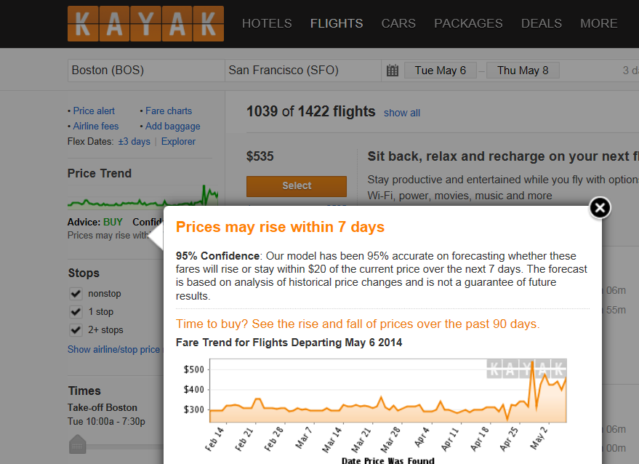
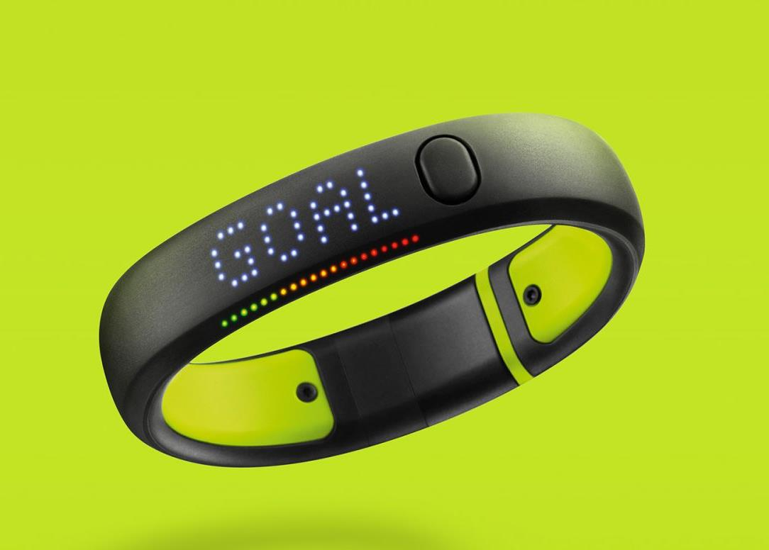
Inform me
Connect me
Motovate me
Notes:
Good applications will:
- Inform: customers pay attention when they are offered helpful and useful trending data like Kayak which can tell you the best dates to by airline tickets at the lowest price based on historical data.
- Connect: Open data builds connections when the data meets the customers at the right time. Like this subway shopping app that combines QR codes, a shopping basket, and your local grocery. This is an app that blends advertising and shopping, and geo-locations.
- Motivate: The ultimate goal of an app is to influence user behavior. - Data and context drive participation and engagement.
- Today’s data consumer is all about getting the data they want, when they want it, and how they want it.
- The data impacts the customer journey.

Slide 6
Focus on the “last mile” of Open Data
2

Slide 7
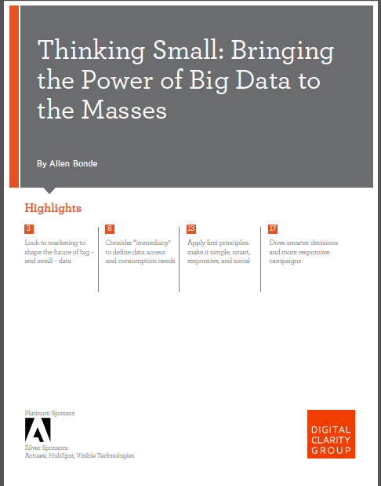
DCG Study
Taking a user-centric view means shifting beyond the three V’s of big data and adding a new V: VALUE
“Empower users with visual elements and engaging experiences”
“make apps simple enough for (users) who aren’t data scientists to get just the information they need”
Notes:
A recent study by the Digital Clarity Group (DCG) encourages us to think beyond the big data 3 V’s of Volume, Velocity, and Variety (Veracity or Uncertainty) and add VALUE thinking.
The last mile, or final delivery, of data where opinions are formed and actions are taken.
App designers must understand self-service use cases based on the 4 V’s and leverage tools that turn Big Data into “small data” that helps people perform certain tasks.
Keep it simple!

Slide 8
Build to Scale (sources, formats, devices)
3
Notes:
Build to Scale: start small but GROW

Slide 9
Customer Facing Applications
Complexity Grows as You Add Users and Data
Online
Commerce
HR Portal
Asset Management
Information
Portal
Design
Challenges
Data Access
Management
Delivery
Government
Portal
Treasury
Services
Merchant
Reporting
Sales
Enablement Portal
Number of users
Product Support
Volume of personalized data per user
Notes:
The apps in the upper-right quadrant often start as smaller departmental applications that grow into large complex enterprise-wide applications and now need to add a personalized “small data” component. For example, an HR Portal may handle hundreds of thousands of employees across the entire agency.

Slide 10
Challenges of Building Data-Driven Customer Facing Applications
Access data
Ever increasing volume and velocity of data
Diverse sources of data – RDBMS, NoSQL/NewSQL, Hadoop, Cloud, Social Media, Document Archive
Manage data and applications
Agile development with rapid time to value
Controllable, predictable costs
Deliver large scale applications
Highly branded, zero-training, engaging personalized UI that integrates with other corporate apps
Secure web and mobile delivery
Notes:
10
You build to scale by:
1) Providing secure access to large volumes of diverse data sources that include cloud-based, No-SQL, Social Media, and document Archives
2) Provide agile development with rapid delivery, but with predictable quality and costs.
3) And deliver Large-scale applications with easy-to-use personalized UI’s, and integrate with other agency applications.
This is what Actuate’s BIRT platform is focused on.

Slide 11
Follow the crowd (open is better)
4

Slide 12
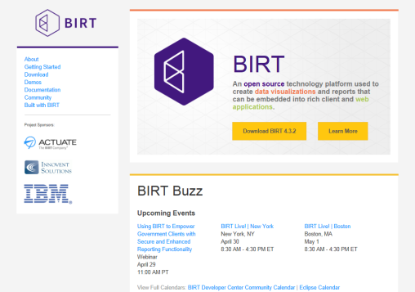
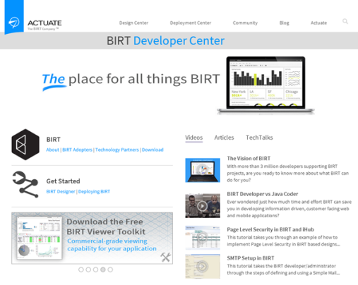
BIRT Development Environment
Full featured, stand-alone development environment supported by active community and backed by Actuate
Top-level Eclipse project since 2004 More than 13 million downloads More than 3.5 million developers Active online community
Lowers development cost and mitigates risk
Notes:
Actuate BIRT started in the Open Source community.
We listened to the community, incorporated their feedback, and gave the crowd our core open-source BIRT reporting engine in 2004.
3.5 million BIRT developers gives our customers access to many resources to ensure projects are delivered on time and with minimal risk.
Actuate BIRT is available in both open-source (free) and commercial.

Slide 13
BIRT iHub - Store, Manage, Generate and Deliver Visualizations on Centralized, Secure Server
CLOUD ARCHITECTURE
Interactive Viewer
Metrics Manager
Dashboard
BIRT Studio
BIRT iHub
RDBMS, NoSQL/NewSQL, Hadoop, Cloud, Social Media, Enterprise Applications, Document Archives, Print Streams, Data Warehouses
Notes:
The BIRT iHub provides the scalable secure access to data and applications with the personalized experience through the Interactive Viewer and Dashboards, ad-hoc reporting via BIRT Studio, and robust KPI management through our Metrics Manager.
BIRT includes some APIs that let you integrate and embed BIRT content in your enterprise and mobile applications.

Slide 14
Start small, then think BIG
5

Slide 15
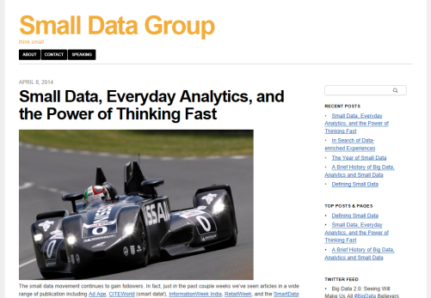
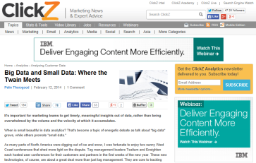
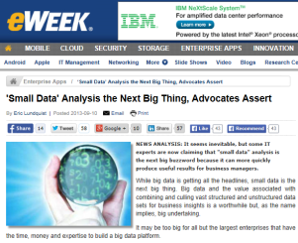
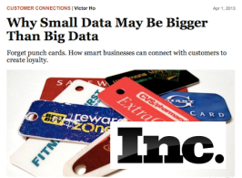
Small Data Philosophy
Make it simple
Make it smart
Be responsive
Be social
Definition: “Small data connects people with timely, meaningful insights (derived from big data and/or “local” sources), organized and packaged – often visually – to be accessible, understandable, and actionable for everyday tasks” (DCG study)
Notes:
Apps should be straight forward and easy to use.
Apps should be smart enough to handle role-specific tasks.
Apps should deliver value on a variety of platforms
Apps should securely connect users and data to the larger world.

Slide 16
BIRT Simplifies
Data Integration
Functional Layout & Integration
BIRT
Application
Design
BIRT Design
Integrates many data sources
Familiar web-centric design
Build modular, maintainable apps
Scale to millions
Instant interactivity
Multi-tenancy
Scalability & Manageability
Instant Interactivity & Self Service
BIRT iHub Services
BIRT iHub
Notes:
Actuate BIRT and iHub meets these design principles.
OSBIRT and BIRT Designer Pro provide powerful development environments.
BIRT iHub delivers an enterprise-scale deployment platform, can integrate with all data sources, presents data in web-centric and mobile formats, and can be embedded in modular, maintainable applications.
BIRT and iHub simplifies delivery of open data insights to virtually any channel.

Slide 17
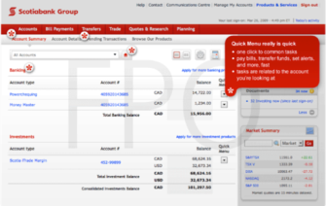
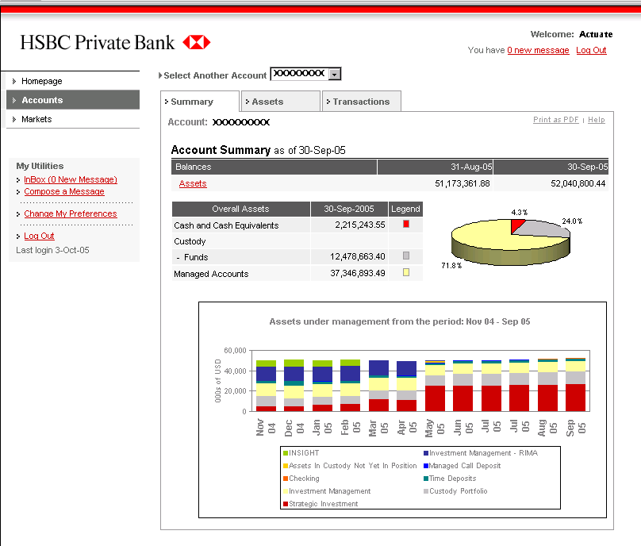
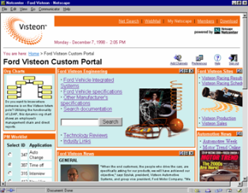
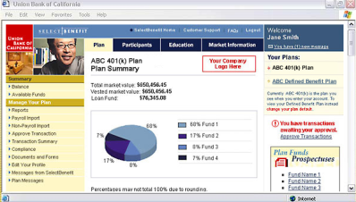
Large Scale Projects Powered by BIRT
Actuate strengthens brands and customer loyalty by delivering timely, personalized insights in customer-facing applications
Finance
Next-generation treasury application GLOBAL BANK
Loan tracking, cross-sell and anti-money laundering CONSUMER BANK
Telecommunications
National sales compensation MAJOR TELCO
Government
Flight Control & Traffic Management
FAA
Personnel & Pay System for 1M+ soldiers
ARMY
Patient care and financial management UK HEALTH AGENCY
Notes:
17

Slide 18
Enhance Software and Appliance Offerings
Seamlessly embed insights into apps and devices
Embed BIRT into applications
Add interactive, dynamic web reports, dashboards and analytics
Make app information more accessible and instantly usable
Deploy applications with BIRT iHub
Deploy BIRT-enabled apps to any user community with unrivaled scalability, performance and reliability
Manage the distribution, security and accessibility of reports, dashboards and application data
BIRT Embedded in OEM and SaaS offerings
… and other partners
Notes:
BIRT is embedded in many other applications used throughout the Federal Government including Maximo, Rational, Truex, Remedy, CGI Momentum, IDS (Air Force).

Slide 19
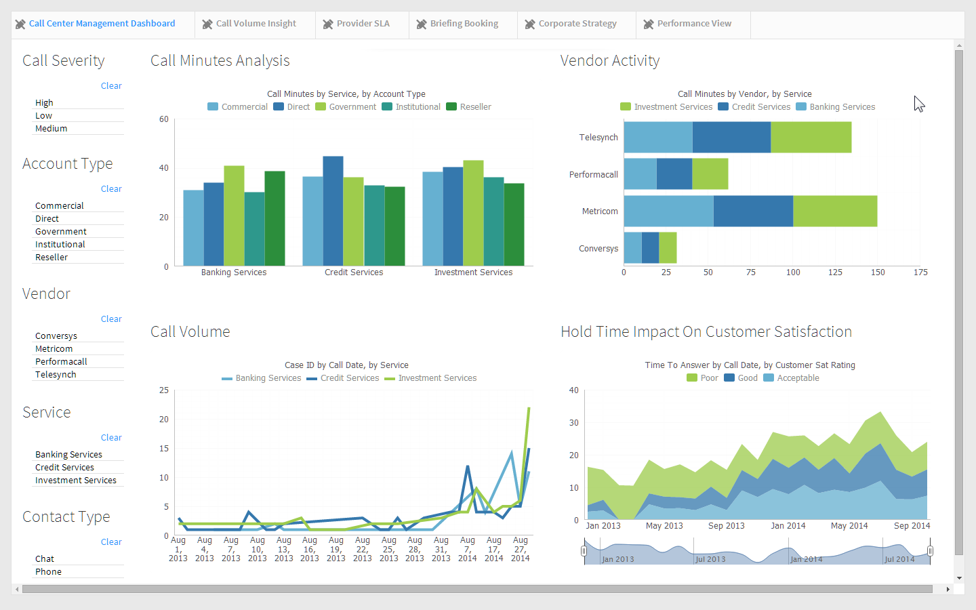
Notes:
Example of a BIRT big-data driven app

Slide 20
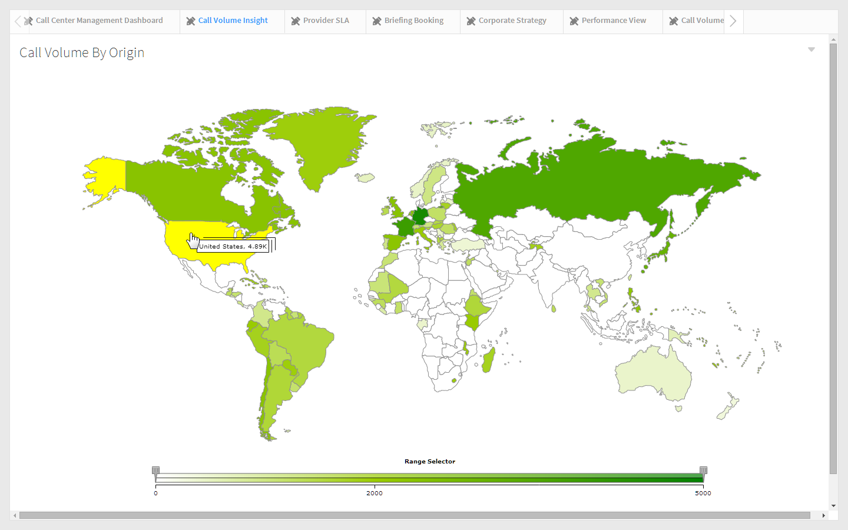

Slide 21
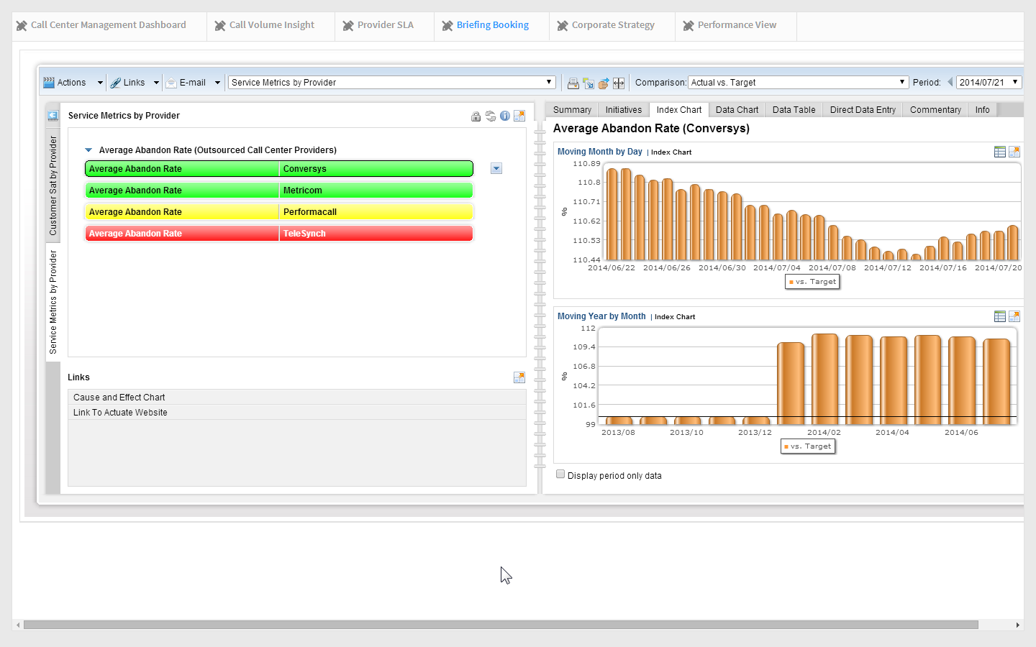
Notes:
Click the "AVERAGE ABANDON RATE" (red measure) for TeleSynch, point out the supplemental information dashboard tabs on the right side of the book, they are the same tabs we saw when drilling from the "Moving 30 Days" chart gadget earlier. Point out comment entered earlier.

Slide 22
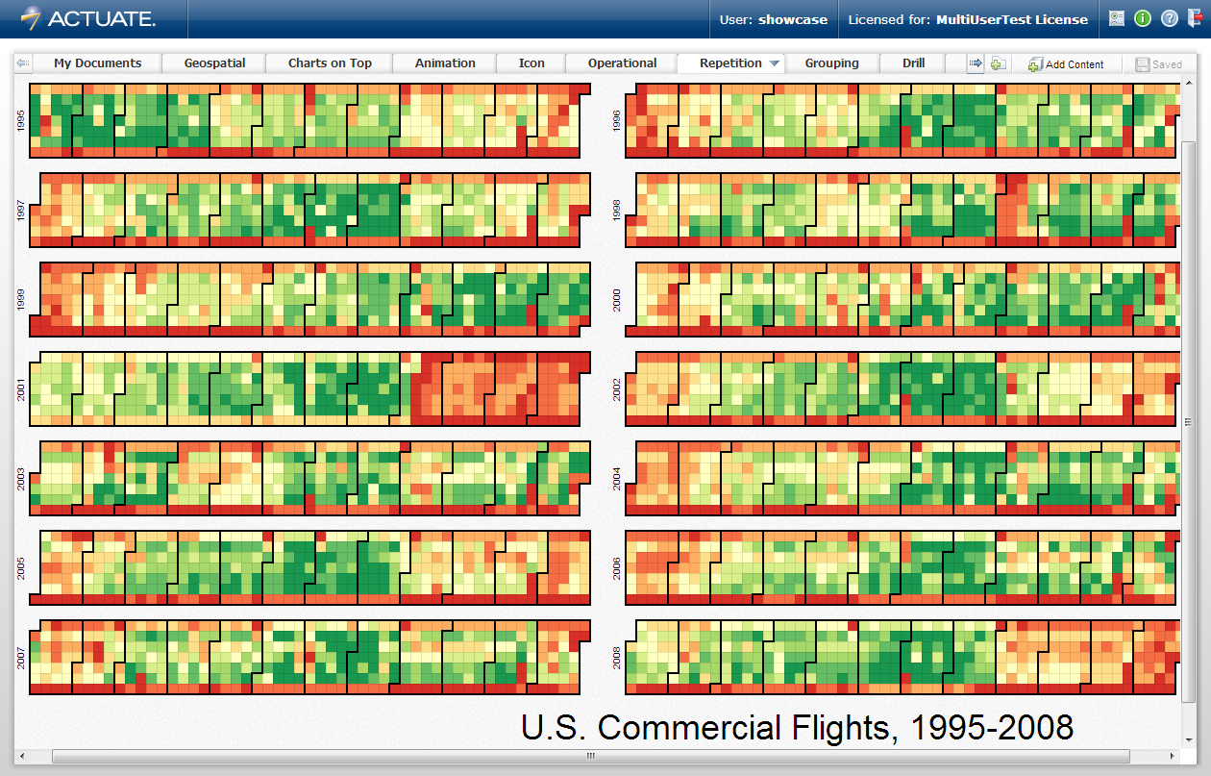
Repetition

Slide 23
Recap – 5 Best Practices for Designing Open-Data Apps
Map the customer journey
Focus on the last mile of big data
Build to scale (foundation)
Follow the crowd (think open)
Start small, then think BIG
The Data Driven World
Self-service, data-driven, customer facing apps that deliver personalized analytics and insights drive the next wave of customer experience

Slide 24
Visit www.actuate.com
Notes:
Visit our table for additional papers around these topics.
Visit www.Actuate.com for upcoming events like BIRT Live.

