Slide 2
Citizen Engagement: Essential for a 21st Century Government
Rick Parrish
Senior Analyst, Serving Customer Experience Professionals
rparrish@Forrester.com
@RickParrishGCX

Slide 3
Success Means…
Happier customers, greater efficiencies, and positive attention
Customer Satisfaction
Budget
Loyalty
Great Ideas
and Solutions
Positive Media Attention
Value for the taxpayer
Employee Engagement
Internal Efficiencies
© 2012 Forrester Research, Inc. Reproduction Prohibited
3

Slide 4
Three aspects of government customer loyalty

Slide 5
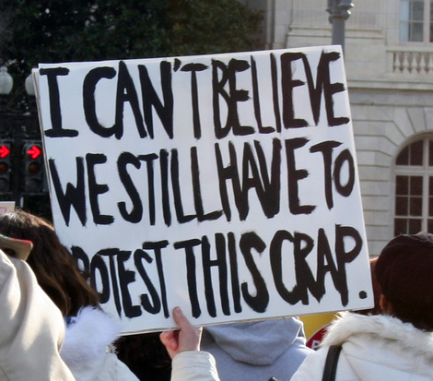
Failure Means…
Problems with the public, Congress, and employees
Employee engagement
Embarrassment
Unwelcome scrutiny and oversight
Faith in government
Pride in the country
Brain drain
“Early retirements”
Optimism in the country’s future

Slide 6
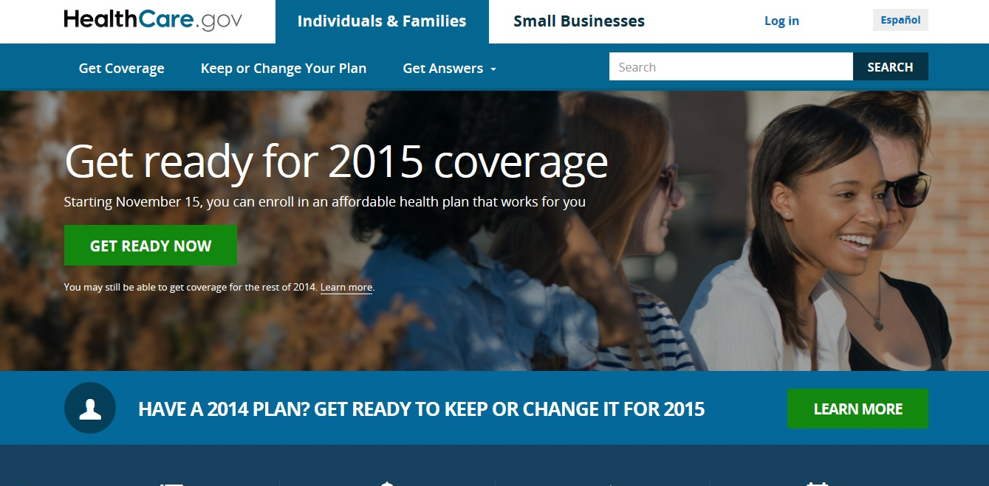
Notes:
Don’t believe me?! Healthcare.gov was a CX failure. The results:
Made HHS a laughingstock – HC.gov became a punchline. Probably the most attention HHS has ever gotten, and it was all negative.
Undermined implementation of the ACA itself – Lawmakers from both parties and 71% of the public said gov should delay the individual mandate. Amin cited problems with the site when it delayed deadlines for registration, insurers’ date to set coverage rates, and small business enrollment
Damaged the President’s credibility – 4/10 considered Obama an effective manager of the federal government; overall approval ratings bottomed out. Hc.gov was a factor.
Led to at least one resignation – Former HHS Secretary Sebelius

Slide 7
The Mandate Is Growing
You can’t wait this one out
EO 12862 – Setting Customer Service Standards
US Digital Services Playbook
Executive Memo on Conducting “Conversations With America” To Improve Customer Service
EO 13571 – Streamlining Service Delivery And Improving Customer Service
Customer expectations
will keep growing
1990
2000
2010
2020
Customer Service Cross-Agency Priority Goal
The E-Government Act of 2002
Expectmore.gov
Connect.gov Single Sign-On
Executive Memo on Improving Customer Service

Slide 8
A revolution is coming
Washington is going to end up looking – and acting – differently
Greater internal capabilities
More methodological standardization
More (and better) value co-creation
More chief customer officers and the growth of “CX professional” as a federal career track
CX metrics for everyone
Notes:
This is not your father’s citizen engagement. It’s not even your older brother’s citizen engagement.
Greater internal capabilities – expansion of what Martha’s office is doing; bigger and better USDS, OPM Innovation lab, more UX labs like the new one in NCI, agency-specific digital services teams modeled on USDS (like the one for which VA is hiring 10 GS-15s)
More value co-creation – just means engaging citizens to create new thing, like crowdsourcing solutions, open APIs so people can use gov data to build apps or other things (TSA is a leader in the crowdsourcing thing; some great gov apps)
More methodological standardization – Coalescing about the USDS playbook
More CCOs and CX Pro fed career track – GSA was 3rd agency to add CCO. SSA and other agencies studying the idea. OMB’s CX community of practice. ACT-IAC’s nascent CX COP, more federal jobs dedicated to CX roles (no longer part of “other duties as assigned”)

Slide 9
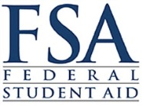
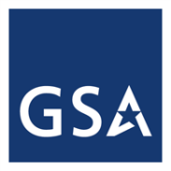
No excuses!
Government is different, but not THAT different
Ossified organizations
Complex regulatory environment
Shortsightedness
Budget constraints
All publicly traded companies
EVERYONE!
Notes:
By the way, think your agency can’t achieve what is being asked of it?
Exact same objections we hear from the private sector!
Microsoft – CXi score up almost every year, almost 10 point increase last year, now at 82
USAA – A serial CX innovator and perennial leader in the CXi and every basic CSAT metric
Publicly Traded Companies – 1/4ly investor calls, annual reports
Everyone – Remember that often better CX saves money.

Slide 10
Rick Parrish
Senior Analyst, Serving Customer Experience Professionals
rparrish@Forrester.com
@RickParrishGCX

