Slide 1
Defending Your Castle
Drew Reinders | GSEC
Principal Solutions Engineer

Slide 2
THREAT
LANDSCAPE

Slide 3
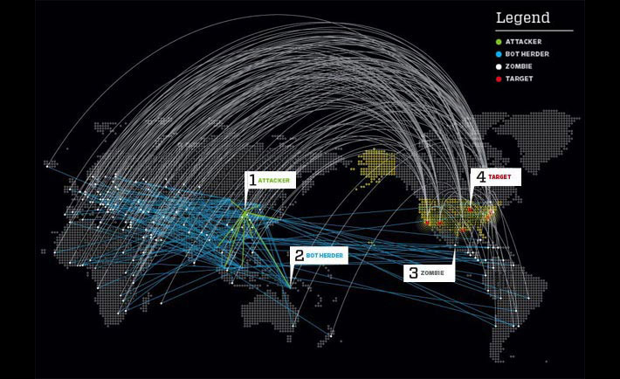
Daily Attack Size
1
50
Gbps
Gbps
2008
2009
2010
2011
2012
2013
2014
Source: Akamai

Slide 4
Attacks Are Growing in Size
Modern attacks harness the scale of growing botnets
2014e
275
270
2013
160
144
2011
2012
Gbps
2010
82
Mpps
2009
79
2008
68
69
2006
2007
39
48
45
2005
29
38
18
22
15
11
2
8
11

Slide 5
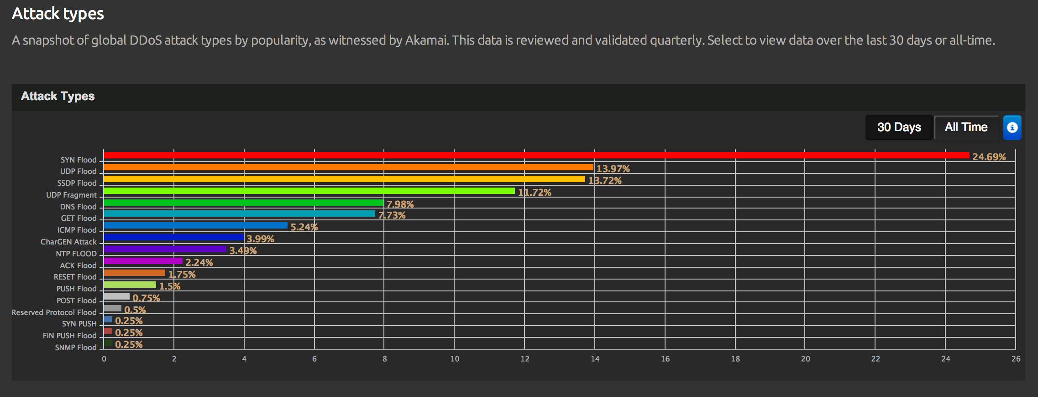
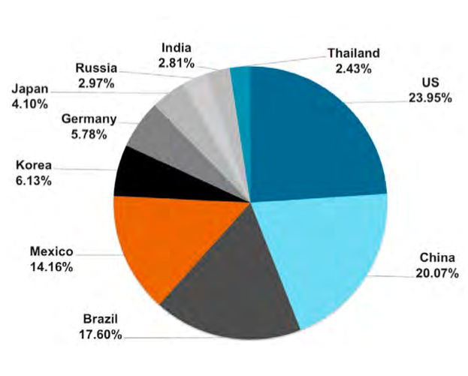
Attack Types – Last 30 Days
Source: Akamai

Slide 6
Targeting Applications for Data Theft
Increasing number of attacks focused on data and financial theft
SQL injection is the primary culprit in 30% of data breaches
Web applications are responsible for 54% of hacking-based data breaches
3 out of 4 will be targeted by Web application exploits
Source: Veracode

Slide 7
Cost of Data Breach
Cost per Record Breached ~$188-199
Brand and Loyalty Impact is Significant
Breaches Impact Business Operations
Remediation Activity is Costly
Top Executives have been Replaced
Data Breach Risk Can’t be Transferred
Cost per Record * Number of Records = Cost of Breach
Ponemon Institute: http://www.ponemon.org/library/2013-cost-of-data-breach-global-analysis
ABCNews: http://abcnews.go.com/Business/video/big-number-target-ceo-loses-job-security-breach-23588889

Slide 8
Attackers Using Old and New Techniques
Recent Techniques
Application Attack, Reconnaissance - Prolific Vulnerability Scanning
Application Attack - Skipfish RFI/LFI to Compromise Host
Application Attack - Injection Attacks
Capacity Attack – Targeting DNS
Capacity Attack - DNS Reflection & Amplification
Capacity Attack – Request Floods (DirtJumper)
Capacity Attack - NTP Amplification (366x amplification factor)
Capacity Attack - Resource Intensive Requests (Search, Login, etc.)
Extortion – DDoS Pay and Stop, for a while
Fraud - Account Checkers and Harvesters
Defense MUST Adapt to Evolving Landscape

Slide 9
MULTI
PERIMETER

Slide 10
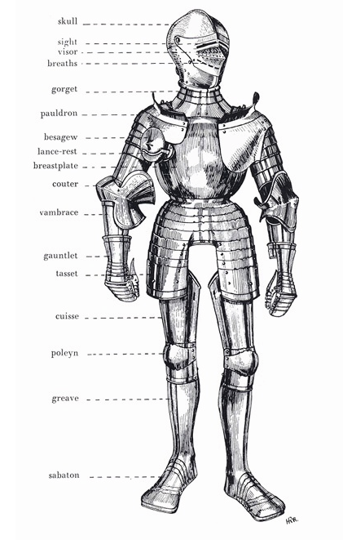
Application Defense

Slide 11
Multiple Perimeters for Internet-facing Applications
Internet
Web
Retrieving content and data
User
Origin
Supporting infrastructure and other applications
DNS
Finding the application

Slide 12
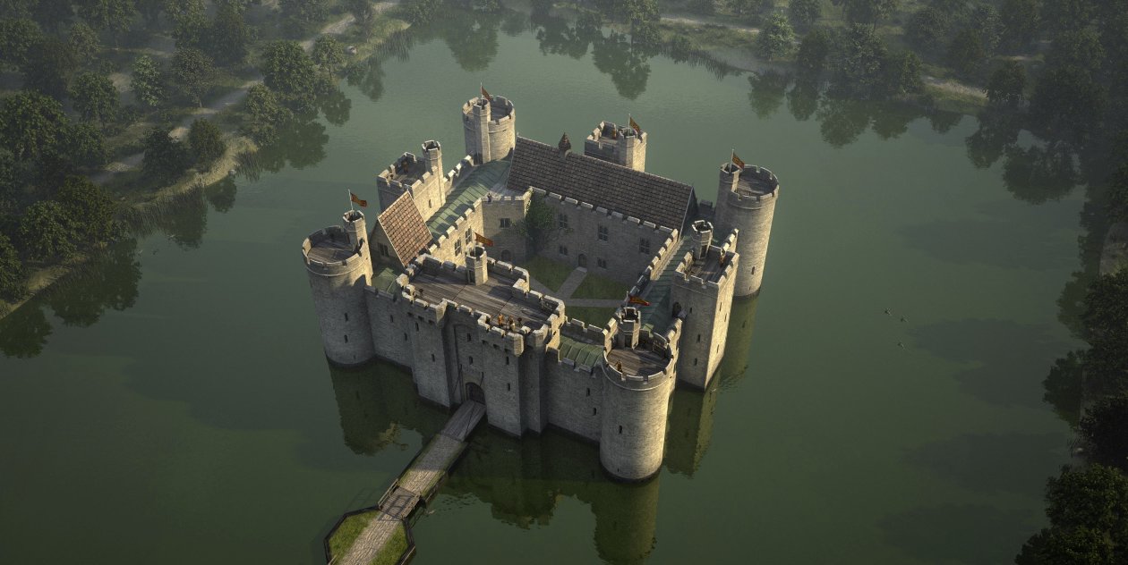
Layered Defense

Slide 13
Nine Layers of Cloud Security
Cloud security platform with massive scale
Reverse proxy automatically drops network-layer attacks
Geo-based blocking
Validating attackers against known lists
Adaptive rate controls provide rapid and automated response
Web application firewall with an Evolving Rule Set
Natural resiliency through caching
Leverage visibility of evolving attack vectors
Require cloud service providers to meet FedRAMP requirements

Slide 14
There are no rules of architecture for castles in the clouds.
-Gilbert K. Chesterton

