Slide 1
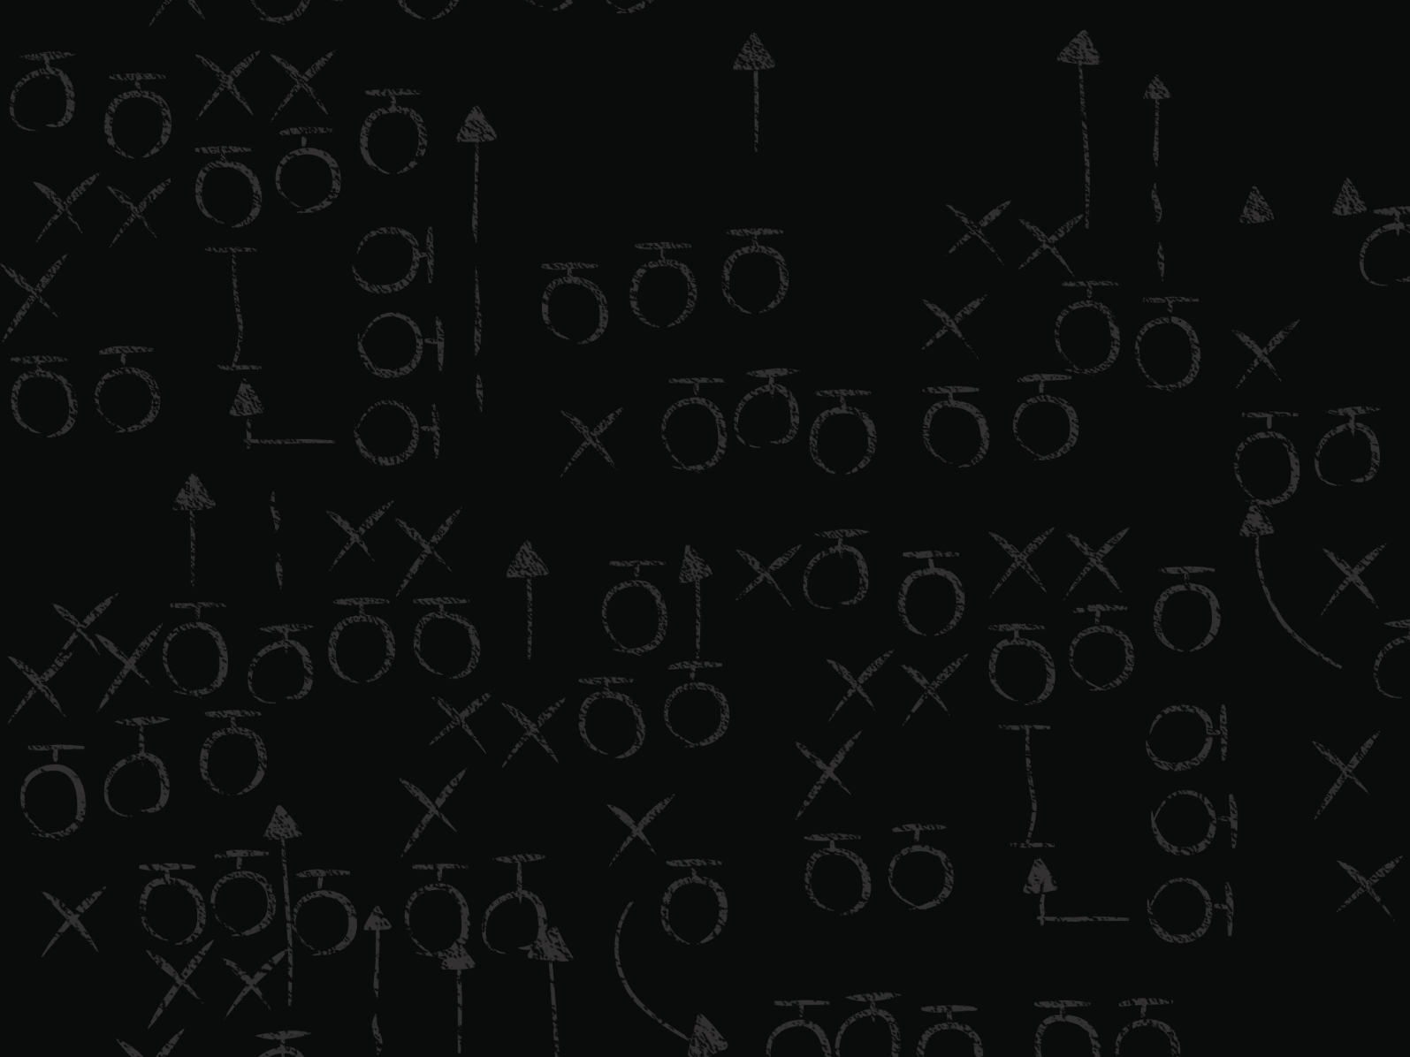
SPEAKER BLITZ
GINA SCINTA
Senior Solutions Architect
SafeNet

Slide 2
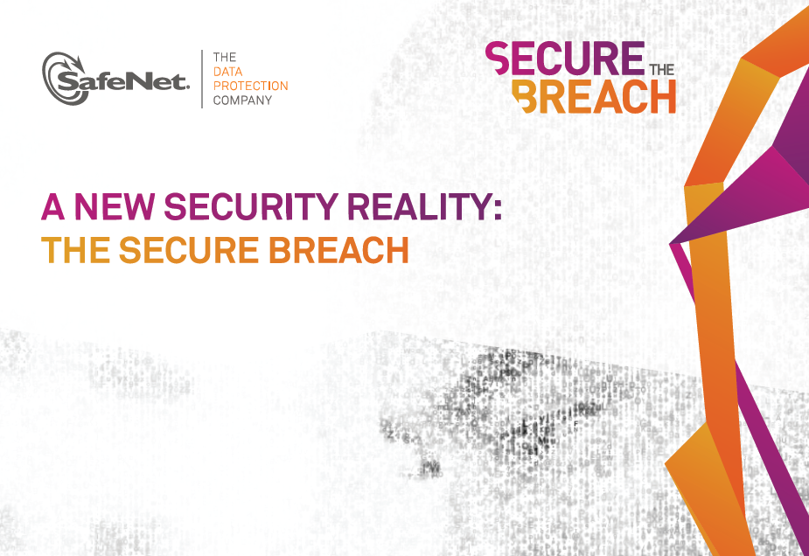
Gina Scinta
Senior Solutions Architect
Gina.Scinta@safenet-inc.com

Slide 3
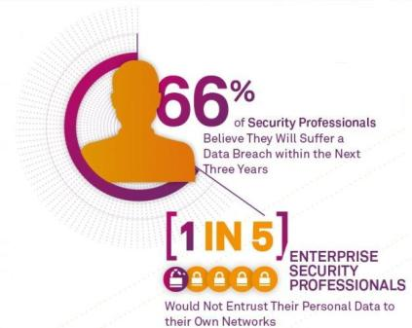
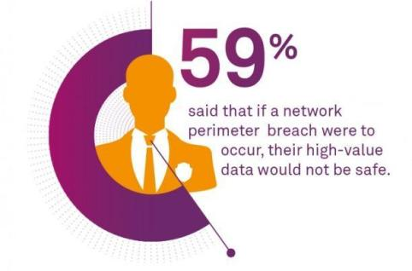
State of Data Security
Security professionals believe they will suffer a breach.
Recognition that if perimeters failed, high value data would not be safe.
*Based on a SafeNet Survey of 230 security professionals.

Slide 4
Breach Level Index
2014
2,364,275,7171
RECORDS STOLEN Since 2013
Organization Breached | Date Breached | Records Breached | Location | Source of Breach | Type of Breach
IRS | 7/22/2014 | 1,400,000 | US | Accidental Loss | Identity Theft
GSA | 2/13/2013 | 700,000 | US | Accidental Loss | Identity Theft
Pentagon | 3/13/2013 | 500,000 | US | Malicious Outsider | Existential Data
Dept. of Energy | 7/22/2013 | 104,179 | US | Malicious Outsider | Identity Theft
US Troops Stationed in South Korea | 6/8/2013 | 100,000 | South Korea | Malicious Outsider | Identity Theft
IRS | 3/18/2014 | 20,000 | US | Accidental Loss | Identity Theft
VFW | 3/4/2014 | 55,000 | US | Malicious Outsider | Identity Theft
FDA | 10/15/2013 | 14,000 | US | Malicious Outsider | Identity Theft
VA | 1/17/2014 | 5,351 | US | Accidental Loss | Identity Theft
Notes:
YOU must assume that the breach will happen - no organization/agency/department is immune. In fact, many of the companies we use everyday and trust with our data are being breached.
This the number of data records that were lost or stolen so far in 2014. The numbers are based on the SafeNet Breach Level Index, which compiles all publicly available information on data breaches – not only in the US but globally.

Slide 5




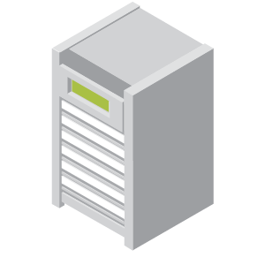

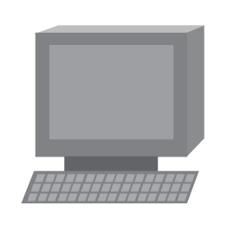


Ground Zero of the Breach Epidemic
Who Has Access to Sensitive Data?
50–80% of Attacks Originate behind the Firewall (Source: FBI)
Accidental Loss
Nuisance
Network
Administrators
Storage
Administrators
Outsourcing
Vendors
Source of the Breach
Type of Breach
Mission
Hacktivist
Account Access
Storage
State Sponsored
PII or CBI
Financial Access
SBU
CFO
Malicious Outsider
Confidential
Identity Theft
Storage Repair/
Service Staff
DR Storage
Administrators
Malicious Insider
Classified
Existential Data
System
Owner
Tape
Courier
System
Administrators
Backup
Administrators
Notes:
State Sponsored Attackers
Make up 4% of the breaches
44 incidents globally YTD
Prime target locations:
Israel
US
Examples: Lockheed Martin, CENTCOM, US Gov Websites
European countries
Prime motive: nuisance & existential data
Malicious Outsiders
Responsible for more than half of the attacks reported YTD
616 incidents globally
1.4B records breached in the last 6 months
Prime motives:
Account access
Identity theft
Financial access

Slide 6
Data Breach Fallout
Cost associated with retroactively protecting data
Cost of investigating the source of the breach
Cost of what happens with the compromise data
Cost of damaged reputation
Bottom Line:
Breaches are Costly

Slide 7
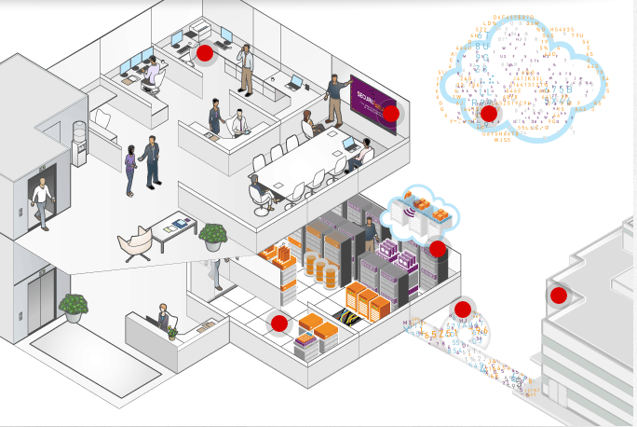
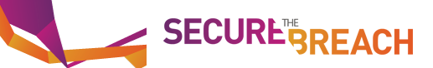

A New Mindset is Needed!
DATA IS THE NEW PERIMETER!
Sole Perimeter Security is No Longer Enough
Insider Threat is Greater Than Ever
Breaches Will Happen and We Must Prepare Differently
Control User Access
Protect Data in the Cloud
Encrypt
Data at Rest
Control Offsite User Access
Protect Data in Transit
Store & Manage Crypto Keys
Notes:
Before we get into the how, lets make sure you understand the new reality of data protection. New technologies – like the cloud, mobility, virtualization – and the consumerization of IT are transforming how applications and services are delivered and how data and information is accessed.
Perimeter security used to be enough. It used to be good enough to put up a big wall around your sensitive information and encrypt that data between gated sites. That is no longer the case. Data is in more places than ever before and our enemies are not obvious. The only way to be truly certain that your data is safe is to encrypt the data itself wherever it resides. At SafeNet we have coined the phrase “securing the breach”. Organizations have to accept that their “perimeter” security can and will be breached at some point – but if the data behind the walls is encrypted, the breach is inconvenient, not detrimental.

Slide 8
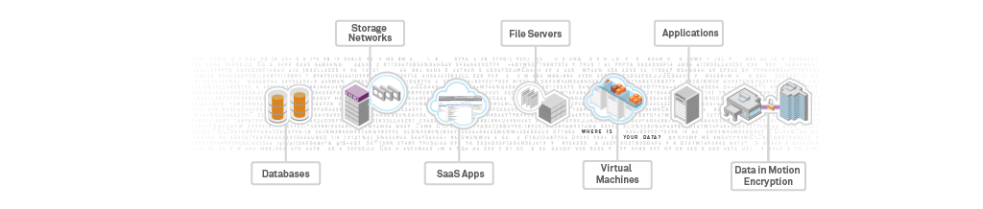



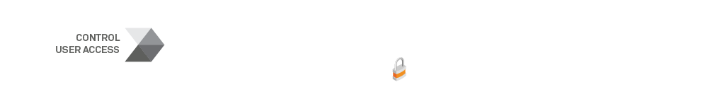
Protect What Matters, Where it Matters
WHERE is
your DATA?
WHERE are
your KEYS?
WHO is
Accessing
your DATA?
Notes:
An organization has to consider three factors when building a comprehensive data protection strategy. First, where does their sensitive data live? There is customer and employee data residing typically in databases, financial information in file servers, and back-up in storage networks. Then there is enterprise data sitting in the cloud – associated with applications such as SFDC. At least in physical data centers, enterprises are aware of where the data is…but as data centers get virtualized and move to cloud, the enterprises fear losing control over their sensitive data. But, in all scenarios, the bottom line is that organizations have to be able to encrypt their data: structured, unstructured, virtualized or cloud.
Corollary to encryption is key management – your encryption can easily be undermined if you don’t have strong key management. Key management is a complex problem – strength of the keys, rollover policies – all depending upon the type of application or data you are encrypting.
And finally, it is not just about encryption, you still have to control who has access to what application, data. Compliance mandates require clear separation of duty – which plays into strong authentication and authorization implementations within the enterprise.

Slide 9
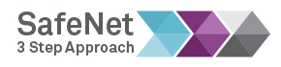
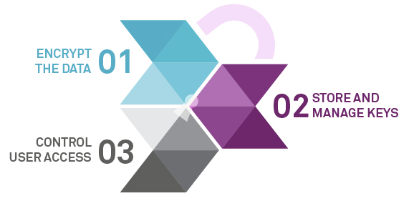
Notes:
Taking all of these vulnerability points into consideration, there are three steps that every company should adopt into their strategy to mitigate the overall cost and adverse consequences that result from a security breach.
01 - Encrypt all sensitive data at rest and in motion. Decide where encryption should be employed, factoring in threat
levels, characteristics of the data and current infrastructure.
02 - Securely manage and store all of your encryption keys. A crypto management platform factors in key management - including, rotating, deleting and creating keys, as well as provides an additional trust anchor for encryption keys using Hardware Security Modules (HSMs).
03 - Control user access. Establish your authentication strategy to protect user identities while ensuring that only authorized users have access to the systems, data and applications they are entitled.
By implementing each of these three steps into your IT infrastructure, you can effectively prepare for a breach, and avoid falling victim to one.

