Slide 1
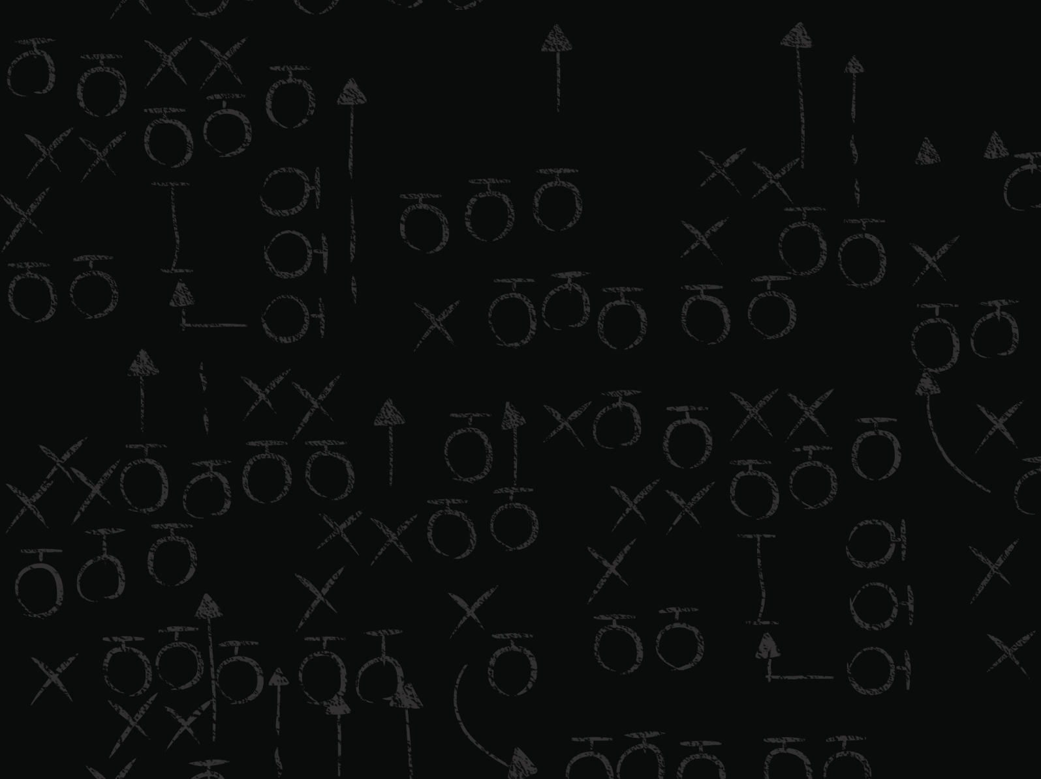
SPEAKER BLITZ
ERIC BROWN
Senior Systems Engineer
NICK JAVANOVIC
DoD Regional Sales Manager

Slide 2
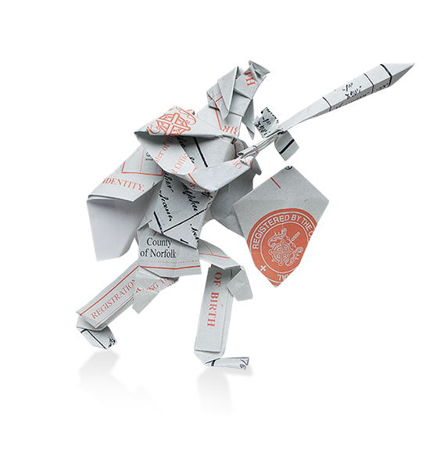
Data Breaches
What have we learned?
INSIDER THREAT REPORT and DATA SECURITY
Nick Jovanovic – DoD Regional Sales Manager
njovanovic@Vormetric.com
Eric Brown – Senior Systems Engineer
ebrown@Vormetric.com
Partners:

Slide 3
Data Breaches
2013
Consumer Records
822 Million Records Exposed
Up from 174 million in 2012
Average cost per record = $136/record
Up $6 from 2012
Trade Secrets / Intellectual Property
Not Disclosed, but much more damaging to Industry and Government
Data can’t defend itself
Motives vary, but the methods are the same.
You must have privilege to compromise data

Slide 4
Beyond Customer Records
What are they after
Intellectual Property / Trade Secrets
Classified Information
Infrastructure Control
Command and Control

Slide 5
Traditional Defenses Are Failing Security Holes are Being Exploited
0%
100%
0%
100%
54%
63%
73%
MORE DIFFICULT TO DETECT AND PREVENT INSIDER ATTACKS THAN 2 YEARS AGO
Feel VULNERABLE TO ABUSE OF PRIVILEGED USERS
DO NOT BLOCK PRIVILEGED USER ACCESS TO SENSITIVE DATA
Global Vormetric Insider Threat survey administered by ESG October 2013
http://enterprise-encryption.vormetric.com/analyst-report-esg-insider-threat

Slide 6
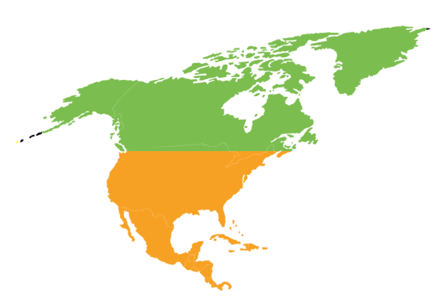
HOW ARE ENTERPRISES
RESPONDING TO THE THREAT?
Using data encryption
68%
Increasing budget
66%
Constantly monitoring data access
49%
Europe feels less vulnerable than the US
25%
Feel vulnerable to insider threats
47%
Concerned with abuse of privileged user access rights
39%
63%
Notes:
Many are taking action – over half (53%) are increasing their security budget due to Insider Threats, and plan to use that budget to invest in security controls to counteract them.

Slide 7
What is the issue?
Superusers control the system, packages, patches, and data permissions
The nature of the superuser is that they have full access to data accessible by the system.
If a superuser is compromised or goes rogue, the impact can be severe, as they can destroy, steal, and manipulate.

Slide 8
Traditional Controls for Super Users
Monitoring
OS Level auditing, keystroke logging, etc…
Privileged Account Management
Checkout account with single usage password
Policy based elevation
Tools that allow a user to elevate to the superuser on a per command basis. sudo, powerbroker, etc…
They are good for saying who can do what as root. But does not control what root can do.
None of these controls stop the superuser…
Just how one becomes the superuser

Slide 9
Common Problem
Malware
Root Kits
Privilege Users
Ransom-ware
All use Ring-0 to steal data

Slide 10
Mission can be accomplished.
“There are products that allow you to encipher your data files, without allowing the admins to have access through the computer network to those data files.
There are commercial products available, the most well known one, Vormetric. “
Bob Bigman - Former CISO, Central Intelligence Agency
June 21, 2013

Slide 11
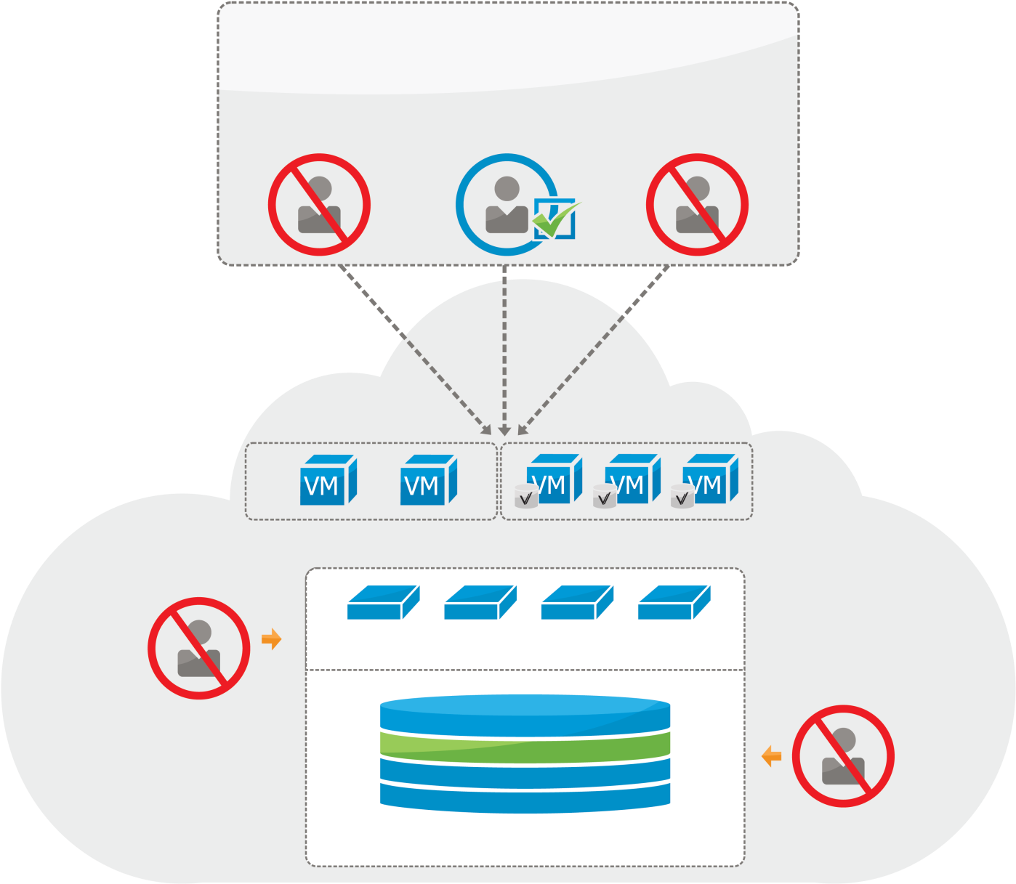
Reduce the impact of misconfiguration and other threats by Firewalling Data
Business Unit
APT, Misconfiguration
Malicious Insiders
Mission User
Enterprise System
Administrator
(Privileged User)
Security Intelligence
Virtualized/Cloud Infrastructure
Hypervisor
Administrator
Virtual Machine Layer
Hypervisor Layer
Storage
Administrator
Encrypted Multi-Tenant Storage
11

Slide 12
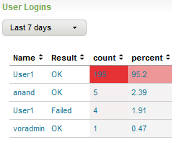
Vormetric Transparent Encryption Simplified encryption and access control
Privileged Users
Combination of approved Users and Processes
SA
user
*$^!@#)(
-|”_}?$%-:>>
root
John Smith
401 Main Street
Encrypted
Clear Text
User
Vormetric
Security
Intelligence
Logs to SIEM
Database
Application
Operating System
Cloud Provider /
Outsource
Administrators
DSM
File
Systems
Volume
Managers
Encrypted
Vormetric
Data Security Manager
on Enterprise premise or in cloud
virtual or physical appliance
Storage
*$^!@#)(
-|”_}?$%-:>>
Big Data, Databases or Files
Notes:
Data encryption
Privileged users access control
Security intelligence
Agnostic to application and storage

Slide 13
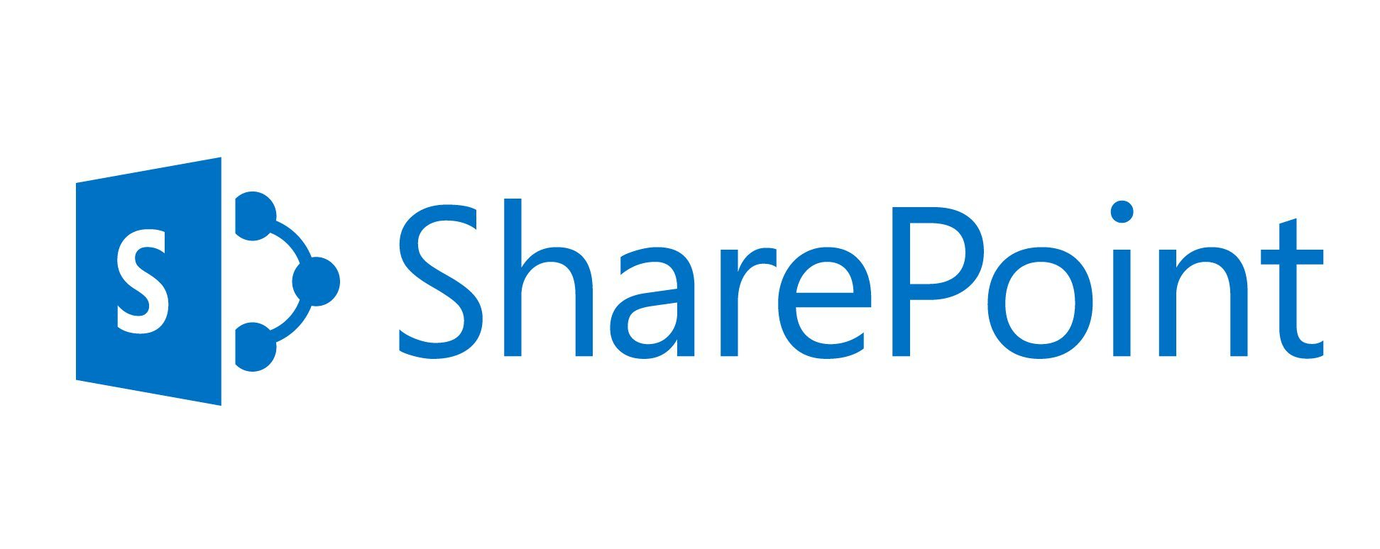
Vormetric: Application and Vendor agnostic through “Learn Mode”

