Slide 1


POWERED BY
Arete-Zoe, LLC

Slide 2

THE MEANING OF INFORMATION
Requirements, needs
Planning, direction
Collection
Processing
Analysis production
Dissemination
Re-evaluation
Need for high quality decisions
Work within available time
Need for Consensus
SCIENTIFIC PUBLICATIONS ARE A SPECIALIZED FIELD OF INTELLIGENCE
Trade offs

Slide 3
SCOPE
Human Medicine
Veterinary medicine
Clinical research
Pharmacovigilance
Drug development
Pharmaceutical research
Epidemiology
Environmental science
Toxicology and forensics
Life Sciences

Slide 4

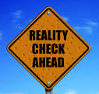
REQUIREMENTS, NEEDS
    S.W.O.T. analyses
    Project pipeline review
    In-project reviews
    Internal safety assessments
    Internal assessments of benefit:risk profile
    Mandatory literature screening and regulatory reports
Reality v. Illusion

Slide 5
PLANNING, DIRECTION
Medical journals
Case histories
Published studies
Reviews, articles, meta-analyses
Patents
Regulatory information
Legal cases, litigation
Press releases
Customer communications
Clinical trial registries
Press, media, tabloids
Disease registries
Treatment guidelines
Safety databases
Industry reports
Competitors’ pipeline assessments
Geopolitical development
Regional / local sources
Social networks
OBJECTIVE
PURPOSE
TARGET AUDIENCE
REGULATORY REQUIREMENTS
MANDATORY SCREENING
DUE DILIGENCE EFFORTS
INTERNAL DECISION-MAKING
PROJECT REVIEWS
BUSINESS DECISIONS
RESEARCH STRATEGIES
RISK EVALUATION
KNOWN KNOWNS
KNOWN UNKNOWNS
KNOWLEDGE GAPS
KNOWN PAST FAILURES
CONFIRMED NEGATIVES

Slide 6
PLANNING, DIRECTION
Background research is a vital component of scientific research process
Literature review refers to an exhaustive, extensive, and systematic examination of available information on the researched subject and provides answers to a defined research problem or question
To determine the extent of current knowledge already developed in order to identify known knowns, known unknowns, and make a qualified estimate of unknown unknowns
To identify the definition of concepts and variables which have already been established in the literature
To examine the research designs and methods, and analytical techniques used by previous researchers and make predictions for methods and research designs which are likely to accomplish the desired outcome
To identify findings relevant for the research subject of interest as well as means and methods which are unlikely to yield a positive result (negative studies)
To become aware of difficulties experienced by others and methods used to overcome them, both successful and unsuccessful

Slide 7
INTELLIGENCE COLLECTION
Basic research, Drug discovery
Academia
Drug discovery, pre-clinical
Biotech
(Pre-clinical), clinical, PMS
Industry Innovator
(Pre-clinical), clinical, PMS
Industry Competitor
Clinical, PMS
Federal Agencies
Clinical, PMS
Hospitals, Others
Objectives
Purpose
Drivers
Motivators
Incentives
Rewards
Funding
Policy
Strategy
Personality
Preferences
Medical Journals
Materials for regulators
(accessible and proprietary)
Materials for business partners
(proprietary)
Communications to customers and the public
Databases,
Registries

Slide 8




DATABASES, REGISTRIES
REGISTRIES
Alzheimer’s Prevention Registry
Breast Cancer Surveillance Consortium
Breast Family Cancer Family Registry
Bronchiectasis Research Registry
Cancer Genetics Network
Clinical Trials Public Data Share Website
Colon Family Cancer Family Registry
CMDIR
DS-Connect™: The Down Syndrome Registry
The Environmental Polymorphisms Registry (EPR) — Using DNA to Study Disease
eyeGENE®: The National Ophthalmic Disease Genotyping and Phenotyping Network
Genetic Testing Registry (GTR)
GenomeConnect
Global Rare Diseases (Patient) Registry and Data Repository (GRDR)
Inherited bone marrow failure syndrome
International Bone Marrow Transplant Registry Database
Lupus Family Registry and Repository
Myasthenia Gravis Patient Registry (etc)
FOIA requests
Archival materials
Customer feedback from internal databases
Primary source data such as EHRs where available and relevant

Slide 9






Our range of expert, focused services to make it easier to know...
How to power selection and collection analysis.
How to help innovate, discover patterns, validate ideas, and go to market.
How to acquire
e-books strategically for libraries and corporations.
How to put the world's validated information within easy reach.
How to manage, link and share citations and writing.
How libraries can work better and invigorate the research experience for users.
Notes:
KEY SLIDE POINTS:
Introduce the core brand promise for each business unit
SCRIPTING:
Each business delivers specialized expertise in an area of focus, making it easier for you to know… <read the business unit promises>.

Slide 10




DATABASES
Comprehensive collection of key biomedical literature from the world’s leading publishers
Leading Content
Embase®
MEDLINE®
BIOSIS Previews®
SciSearch® Current Contents
Chemical Business Newsbase
Derwent Drug File
IMS R&D Focus
Adis R&D Insight
Industry Specific Databases
CAB Abstracts - FSTA
PsycInfo
Incidence & Prevalence

Slide 11
PATENTS COLLECTION
The Patents collection on ProQuest Dialog is a comprehensive collection of authoritative global patent sources. With the full text from 33 country authorities, plus three patent families, it combines precision search with full text availability
INPADOC
ProQuest Dialog complete patent family
Derwent World Patents Index
Derwent patent family, abstracts, assignees
Patents Citation Index
Backward and forward citation coverage
IFI CLAIMS US patents
Unique, enhanced, exclusive content
LitAlert
US patent and trademark litigations
IMS Patents Focus
Drug patent families
Unparalleled collection of
non-patent scientific and technical literature
business literature
global news and trade
prior art
60+ Engineering databases
50+ Biomedical databases
20+ News and Trade databases

Slide 12
DATABASES, REGISTRIES
REGISTRIES
Alzheimer’s Prevention Registry
Breast Cancer Surveillance Consortium
Breast Family Cancer Family Registry
Bronchiectasis Research Registry
Cancer Genetics Network
Clinical Trials Public Data Share Website
Colon Family Cancer Family Registry
CMDIR
DS-Connect™: The Down Syndrome Registry
The Environmental Polymorphisms Registry (EPR) — Using DNA to Study Disease
eyeGENE®: The National Ophthalmic Disease Genotyping and Phenotyping Network
Genetic Testing Registry (GTR)
GenomeConnect
Global Rare Diseases (Patient) Registry and Data Repository (GRDR)
Inherited bone marrow failure syndrome
International Bone Marrow Transplant Registry Database
Lupus Family Registry and Repository
Myasthenia Gravis Patient Registry (TBC)

Slide 13
INFORMATION PROCESSING
INFORMATION
I. USEFULNESS, ACCURACY, CORRECTNESS
II. EVALUATION OF INFORMATION
Source reliability assessment (competency and past behavior based)
Bias assessment (motivators, interests, funding, objectives)
Conflicts of interest
Sources of funding, important business relationships
Grading of individual items (study, report, analysis, article)
III. COLLATION OF INFORMATION
Exclusion of irrelevant, incorrect, and useless information
Arrangement of information in a form which enables real-time analysis
System for rapid retrieval of information
INTELLIGENCE

Slide 14
VALIDITY ASSESSMENT
Components of internal and external validity of controlled clinical trials
Internal validity — extent to which systematic error (bias) is minimized in clinical trials
Selection bias: biased allocation to comparison groups
Performance bias: unequal provision of care apart from treatment under evaluation
Detection bias: biased assessment of outcome
Attrition bias: biased occurrence and handling of deviations from protocol and loss to follow up
External validity — extent to which results of trials provide a correct basis for generalization to other circumstances
Patients: age, sex, severity of disease and risk factors, comorbidity
Treatment regimens: dosage, timing and route of administration, type of treatment within a class of treatments, concomitant treatments
Settings: level of care (primary to tertiary) and experience and specialization of care provider
Modalities of outcomes: type or definition of outcomes and duration of follow up
Assessing the quality of controlled clinical trials. BMJ 2001;323:42

Slide 15
VALIDITY ASSESSMENT
The QUALITY of the finished intelligence product depends directly on the premises that support the inference(s).
Premise VALIDITY is mainly a function of data evaluation
The more CERTAIN the premises, the more ACCURATE the inference(s)
DEVELOPING INFERENCES
(1) Use all applicable, relevant information
(2) Describe and integrate fragmented information
(3) Formulate premises
(4) Develop alternative hypothesis
(5) Use probability values to assess certainty
(6) Avoid logical fallacies
CERTAINTY
PROBABILITY
CONFIDENCE

Slide 16
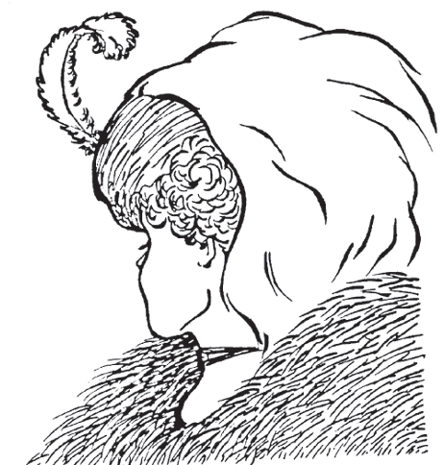
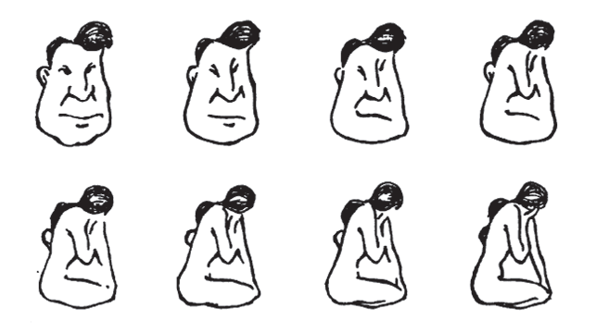
PERCEPTION TRAPS
New information is assimilated to existing images
We tend to perceive what we expect to perceive
Mind-sets tend to be quick to form but resistant to change

Slide 17
COGNITIVE BIASES
Cognitive biases are mental errors caused by our simplified information processing strategies.
Cultural, emotional or intellectual predisposition toward a certain judgment
Distinct from cultural bias, organizational bias, and bias that results from one’s own self-interest
Cognitive biases are similar to optical illusions in that the error remains compelling even when one is fully aware of its nature. Awareness of the bias, by itself, does not produce a more accurate perception.
When evidence is lacking or ambiguous, the analyst evaluates hypotheses by applying his or her general background knowledge concerning the nature of systems and behavior.

Slide 18
COGNITIVE BIASES
Vividness
Vivid, concrete, and personal information has a greater impact than pallid, abstract information that may actually have substantially greater value as evidence
Absence of Evidence
estimate potential impact of missing data and adjust confidence in judgment
Use of FAULT TREES
Oversensitivity to Consistency “out of sight, out of mind”
highly correlated or redundant information, or drawn from a very small or biased sample
Law of Small Numbers - tendency to place too much reliance on small samples
Coping with Evidence of Uncertain Accuracy
Misunderstanding, misperception, incomplete story; source bias; distortion in the communication chain, or misunderstanding and misperception by the analyst
Persistence of Impressions Based on Discredited Evidence
Impressions tend to persist even after the evidence that created those impressions has been fully discredited.
.
Notes:
Evaluation of evidence is a crucial step in analysis, but what evidence people rely on and how they interpret it are influenced by a variety of extraneous factors. We seldom take the absence of evidence into account.
The human mind is also oversensitive to the consistency of the evidence, and insufficiently sensitive to the reliability of the evidence.
Finally, impressions often remain even after the evidence on which they are based has been totally discredited

Slide 19
BIASES IN CAUSE AND EFFECT
Biases in Perception of Cause and Effect
When inferring the causes of behavior, too much weight is accorded to personal qualities and dispositions of the actor and not enough to situational determinants.
Bias in Favor of Causal Explanations
People expect patterned events to look patterned, and random events to look random, but this is not the case. Random events often look patterned.
Bias Favoring Perception of Centralized Direction
Tendency to see the actions of organizations as the intentional result of centralized direction and planning. Accidents, unintended consequences, coincidences, and small causes leading to large effects are perceived as coordinated actions, plans and conspiracies.
Similarity of Cause and Effect
Rule of thumb people use is to consider the similarity between attributes of the cause and attributes of the effect. Assumption that big events have important consequences, does not apply.
Internal vs. External Causes of Behavior (Attributional bias)
A fundamental error made in judging the causes of behavior is to overestimate the role of internal factors and underestimate the role of external factors.
Overestimating Our Own Importance
Individuals and organizations tend to overestimate the extent to which they successfully influence the behavior of others: familiar with own efforts, much less with factors that influenced the other's decision.
Illusory Correlation
Correlation alone does not necessarily imply causation. For example, two events might co-occur because they have a common cause, rather than because one causes the other. But when two events or changes do co-occur, and the time sequence is such that one always follows the other, people often infer that the first caused the second.

Slide 20
PUBLICATION BIAS
Trials reporting positive findings are more likely to be published, and to be published faster, than those reporting negative findings.
Publication of a single study multiple times works like an amplifier which makes anecdotal findings appear more relevant than they really are.
CLINICAL TRIALS
ClinicalTrials.gov
EU CT register
National registries
WHO registry
PUBLICATIONS
Medline
Embase
Derwent Drug File
BIOSIS Previews
SciSearch
IMS R&D Focus
Adis R&D Insight
Unpublished studies
Studies published multiple times
Missing study ID (linking publication to study)
Selective publication of data
Fewer than half of published trials are registered
Fewer than half of registered trials are ever published in peer-reviewed journals

Slide 21
CURVEBALL EFFECT
HUMINT source codenamed ‘Curveball’ proved to be one of the most significant intelligence failures. His account of mobile chemical and biological laboratories in Iraq turned out to be a complete fabrication, yet it was seized upon by the US administration as strong evidence.
FRAUD:
Falsification of data in proposing, designing, performing, recording, supervising or reviewing research, or in reporting research results
Falsification includes both acts of omission (consciously not revealing all data) and commission (consciously altering or fabricating data)
Fraudulent study data:
  → ALL AFFECTED PUBLICATIONS RETRACTED?
  STUDIES NOT ACCEPTED FOR NDAs/ANDAs?
  EXISTING APPROVALS BASED ON CURVEBALL DATA REVIEWED?
Robert FIDDES
Borison-Diamond
Eric Poehlman
Stratton VA
Nicholas Lawrence Adams: Why Did ‘Intelligence’ Fail Britain and America in Iraq? King’s College London Jul 25 2012

Slide 22
DR. ROBERT FIDDES
Robert Fiddes, MD - Private practice, Whittier, CA – 1997
President of a clinical research company in Whittier, CA
Conducted over 200 studies beginning in the early 1990’s
Engaged in extensive fabrication and falsification of data
Removed exclusionary data from medical history in patient charts
Made up fictitious study subjects
Fabricated lab results by substituting clinical specimens and manipulating lab instrumentation
Feb. 1997 – Staffers blow the whistle and FDA special agents storm the site
Aug. 1997 – plead guilty to felony charge of conspiracy to make false statements to the FDA
Sept. 1998 – sentenced to 15 months in federal prison and ordered to pay $800,000 in restitution
June 1999 – disqualified as a clinical investigator by FDA
Mar. 2000 – medical license revoked
Nov. 2002 – debarred by FDA along with three study coordinators
Below, P: Fraud & Misconduct at Investigator Sites, 2007
A Doctor's Drug Trials Turn Into Fraud, 1999

Slide 23
BORISON - DIAMOND
Richard Borison, MD, former psychiatry chief at the Augusta Veterans Affairs medical center, the former chair of MCG's department of psychiatry and health behavior,
Bruce I. Diamond, Ph.D., pharmacologist, once a professor in the department, Medical College of Georgia (MCG)
Borison was sentenced to 15 years in prison + 15 years on probation
Diamond was sentenced to 5 years in prison
Borison and Diamond charged with diverting more than $10 million in research funds
Between 1988 and 1996 Borison and Diamond received contracts for more than 160 studies from industry, including Abbott Laboratories Inc., Hoechst AG, Warner-Lambert Co., Pfizer Inc., Sandoz, Bristol-Myers Squibb Co., Eli Lilly Co. and Glaxo Wellcome PLC.
In at least 44 trials, Borison and Diamond contracted commercial ethics committees (IRBs), some 4,000 km away, instead of locally available IRB
History of misconduct dating back to 1988
1996 US Seroquel® Study Group research is unretracted
Their research is cited in 173 works and medical textbooks
Drugs tested included: Risperidal (risperidone) and Paxil (paroxetine)
AHRP: Scientific Fraud: Eric Poehlman / Richard Borison, 2006
Borison-Diamond: Systemic failure – no checks and balances, WSJ, 1997

Slide 24
ERIC POEHLMAN
Eric Poehlman, at the University of Vermont
sentenced to a year in prison for "lying on a federal grant application”
admitted to fabricating more than a decade's worth of scientific data on obesity, menopause and aging which he presented in lectures and in published papers
used this data to obtain millions of dollars in federal grants from NIH
Poehlman's admission of guilt came after more than five years during which he denied the charges against him, lied under oath and tried to discredit his accusers.
Poehlman earned nearly $140,000, one of the university top salaries
Office of Research Integrity and the Department of Justice uncovered fraudulent research that stretched back through almost half of Poehlman's career.
The revelations led to the retraction or correction of 10 scientific papers, and Poehlman was banned forever from receiving public research money.
“Medical researchers who commit fraud and research misconduct are caught only when a person of conscience steps up to the plate and blows the whistle. There are no systemic, independent checks and balances to prevent research fraud or abuse of patients.” AHRP, 2006
AHRP: Scientific Fraud: Eric Poehlman / Richard Borison, 2006

Slide 25
STRATTON VA MEDICAL CENTER
Paul Kornak, James A. Holland: Stratton VA Medical Center 1999-2003
Paul Kornak, research associate, and Stratton oncology chief Dr. James A. Holland faced federal criminal investigation for at least five deaths at the VA center in clinical studies involving almost 100 patients.
Mr. Kornak was sentenced to a $2,500 fine and three years of probation for forging his credentials to obtain a medical license
According to an F.D.A. letter to Dr. Holland, he delegated far too much responsibility to unqualified subordinates in numerous drug studies.
Kornak pleaded guilty to fraud, making false statements and criminally negligent homicide in the death of an Air Force veteran, James DiGeorgio.
According to Mr. Kornak's lawyer, E. Stewart Jones, there was a "clear systems failure," permitting a research culture where "rules weren't followed, protocols weren't applied and supervision was nonexistent.“
VA internal memorandum in 2003 described as "systemic weaknesses in the human research protections program”, especially in studies funded by industry which form about 80 percent of VA’s human research.
N.Y. Times: Abuses Endangered Veterans in Cancer Drug Experiments, 2005
CIRCARE

Slide 26
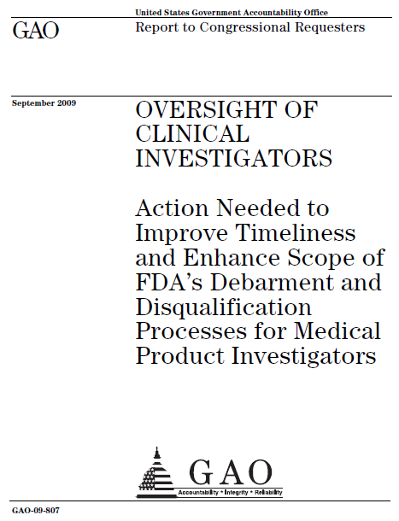
2009 GAO REPORT
The GAO report describes cases in which investigators
Stole study funds
Received illegal Medicare kickbacks
Falsified X-rays and lab tests to fraudulently show efficacy
Manipulated test results
Committed fraud relating to data submissions or patient records,
Committed fraud relating to creating patient records for non-existent patients.

Slide 27
FRAUDULENT RESEARCH
Scott Reuben, MD, was sentenced to six months in prison in 2010.
his “research” on popular pain killers like Celebrex (celecoxib) and Lyrica (pregabalin) is unretracted.
Wayne MacFadden, MD, resigned as US medical director for Seroquel (quetiapine) in 2006, after sexual affairs with two coworker women researchers surfaced, but the related work is unretracted and was even part of Seroquel’s FDA approval package for bipolar disorder
Designwrite - Pfizer’s marketing firm authored more than 50 ghostwritten papers about hormone therapy (HT)
the papers claimed no link between HT and breast cancer
false claims of cardiac and cognitive benefits
none of the articles has been retracted.
Pfizer/Parke-Davis - Neurontin (gabapentin) promotion
13 ghostwritten articles placed in medical journals promoting off-label uses
only Cochrane Database has retracted the specious articles
…FRAUDULENT RESEARCH NOT RETRACTED

Slide 28
FALLACY
Fallacies of Omission
Oversimplification: An inference that fails to account adequately for all of the complex conditions under consideration.
Inadequate sampling: A fallacy produced by drawing inferences (estimates) from samples that are too few or from samples that are not truly representative.
Mistaken cause: An unwarranted cause and effect relationship established between events or conditions that coincidentally exist at the same time or precede one another.
False dilemma: A fallacy in which only the extreme alternatives are considered.
Fallacies of False Assumptions
Begging the question: Instead of responding to the question or problem, the question is rephrased or the problem is replaced with another.
Hypothesis contrary to fact: A fallacy that occurs when someone states decisively what would have happened had the circumstance been different, providing a hypothesis that cannot he verified.
Misused analogies: When reasoning from analogy, the analyst assumes that the object or event in the real world is similar to the object or event in the analogy. Analogies are inappropriate as evidence or proof in analytical work. Analogies are most appropriately used for helping to explain or clarify a concept.

Slide 29
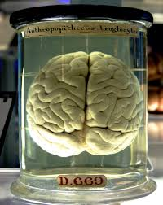
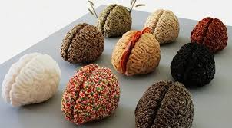
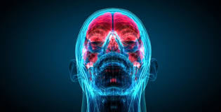
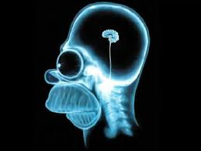

INTELLIGENCE ANALYSIS
DIAGNOSTIC TECHNIQUES:
Key assumption check
Quality of Information check
Indicators or signposts of change
Analysis of competing hypotheses
CONTRARIAN TECHNIQUES:
Devil’s advocacy
Team A & Team B
High-Impact/Low-Probability Analysis
“What If?” Analysis
IMAGINATIVE THINKING TECHNIQUES
Brainstorming
Outside-In Thinking
Red Team Analysis
Alternative Futures Analysis
STRUCTURED ANALYTIC TECHNIQUES

Slide 30
ATTRIBUTES OF GOOD INTELLIGENCE
OBJECTIVITY: Does it avoid mirror imaging, cultural bias, and prejudicial judgments?
RELEVANCE: Does it relate directly to the end user’s area responsibility and mission?
ACCURACY: Did the producer clearly articulate the level of confidence in its accuracy?
PRECISION: Does it have the required level of detail to satisfy the needs of the end user at his or her operational level?
COMPLETENESS: Were all of the user’s requirements addressed in the level of detail necessary to satisfy his or her needs?
USABILITY: Did it arrive in a format that the end user can easily understand and assimilate into his or her decision-making process?
AVAILABILITY: Was it readily accessible to the user at the appropriate security classification or accessibility?
ANTICIPATION: Does it anticipate the intelligence needs of the customer?

Slide 31

DISSEMINATION
Form
Accessibility to individuals and functions
Availability through systems and platforms
Time limitation

Slide 32
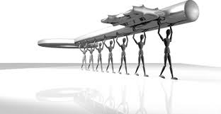
RE-EVALUATION
INTELLIGENCE PROVIDED
Evaluation of its impact
Evaluation of its usefulness
PROCESS
Measurement of effectiveness of the process
Measurement of integrity of the process
Feedback → Adjustment

Slide 33
THANK YOU
ARETE-ZOE, LLC
Registered address: 1334 E Chandler Blvd #5, Box A-19, Phoenix, 85048 AZ
T: +1 480 40 90 778
Skype: arete-zoe
E-mail: veronikav@arete-zoe.com
Website: http://aretezoe.com/
LinkedIn: https://www.linkedin.com/in/veronikavaldova

