Slide 2
Lightning Speaker
Kapil Bakshi
Distinguished Architect

Slide 3
Approaches to Big Data & Analytics
Kapil Bakshi
Distinguished Architect, Cisco System
Oct. 2014

Slide 4
Agenda
THE approach
Big Data Analytics
Network Edge Analytics
Data Virtualization

Slide 5
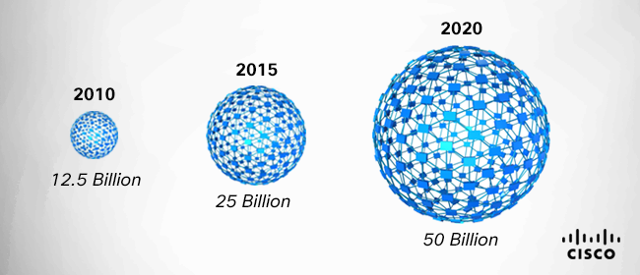
New Data Sources (IoT) Creates Big Data
Volume
Of Data
Internet
of
Things
Video
Social
E-commerce
Email/Web
Heritage Operational Data
Present
Time

Slide 6
Big Data and Analytics Approach
Big Data Analytics in DC or Cloud
Network
Network Edge Analytics
Network
Network
Data Virtualization

Slide 7
Cisco Big Data Analytics Platforms in DC and Cloud
No SQL
MPP Databases
Unstructured
Key-Value Store Database
Document Database
Massively Parallel Processing; RDBMS for EDW
Hadoop
Apache Opens Source Project
Manage and Process Massive Amounts of Data

Slide 8
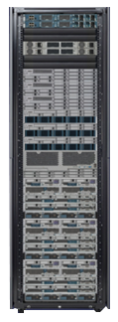
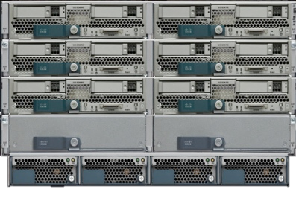
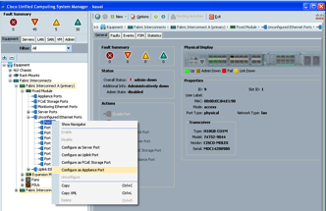
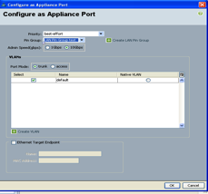
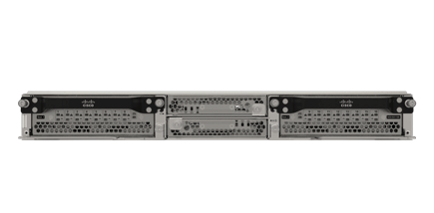
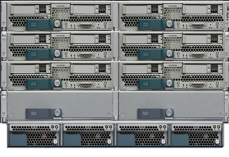
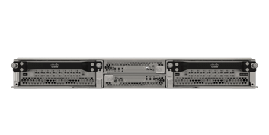
Network Edge Computing Platform – UCS Mini
Edge-Scale Computing
Core Big Data Workloads
UCS Mini
New architectural entry point for IoE and Network Edge Analytics
UCS Mini :
Compute
Solid-state
Networking
UCS Manager
Unified Computing in 6U
Chassis-Integrated Fabric Interconnects
UCS Manager
Standard UCS Blades / Fans / Power Supplies
UCS Mini

Slide 9
How Data Virtualization Works Example Scenario
Agile data integration software that makes it easy to access all your data, no matter where it’s managed, and query it across the network as if it were in a single place.
I need to build BI/Analytics application that looks like this…
1
So the data needs to look like this…
2
But the data comes from these sources, in these formats…
3

Slide 10
Data Virtualization: Big Data Warehouse Expansion
Big Data Warehouse
Expansion Solution
Data Virtualization
Data Warehouse
+
Data Warehouse
UCS
UCS
UCS
Big Data

Slide 11
Big Data and Analytics Approach
Big Data Analytics in DC or Cloud
Network
Network Edge Analytics
Network
Network
Data Virtualization

