Slide 2

Lightning Speaker
Kevin Morgan
Technical Director, Global Government and Healthcare

Slide 3
How to drive big data into the mission
Kevin Morgan, Sr Director Sales Engineering

Slide 4





Data is a Resource

Slide 5

Time to Value

Slide 6
Enterprise Requirements: Power + Agility + Reliability

Slide 7
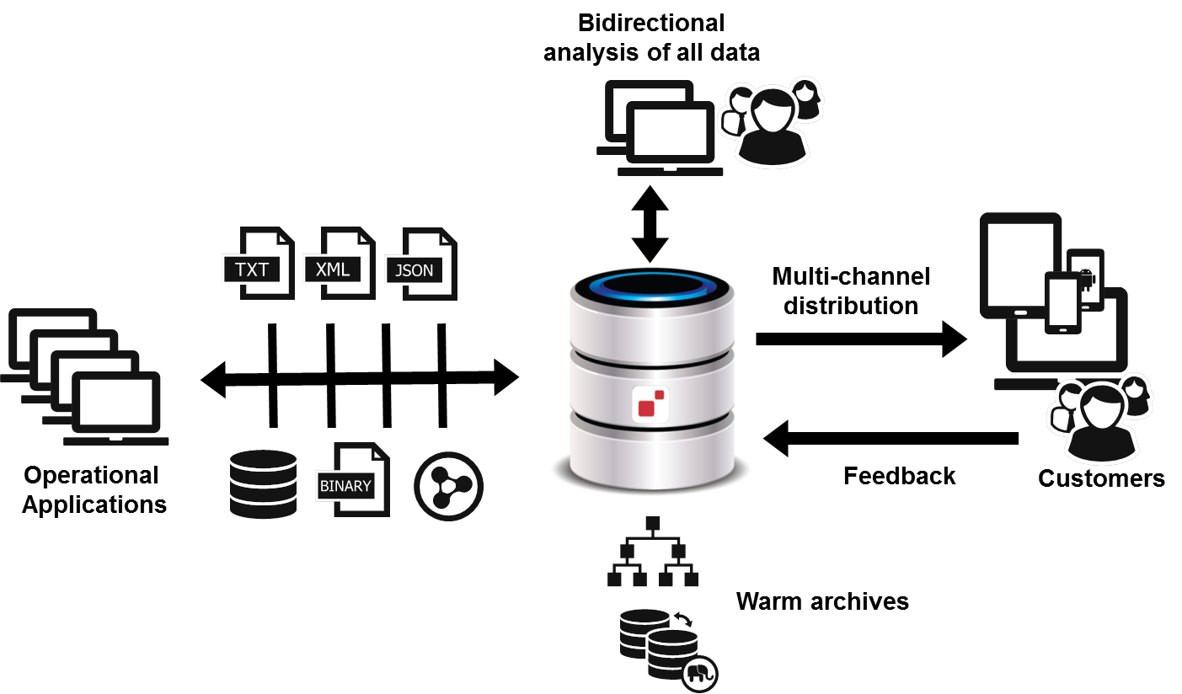
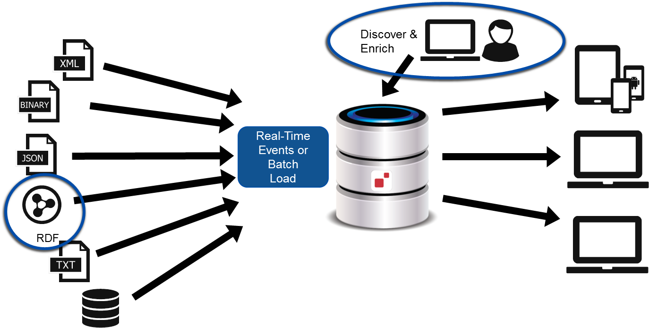
Architectural Patterns
Operational Data Warehouse
Addressing the broken promises of the EDW
Operational Data Hub
Past the Warehouse, and beyond the Lake

