Slide 2
Lightning Speaker
Richard Breakiron
Senior Director of Cyber Solutions

Slide 3
Analytics in the Age of Big Data

Slide 4
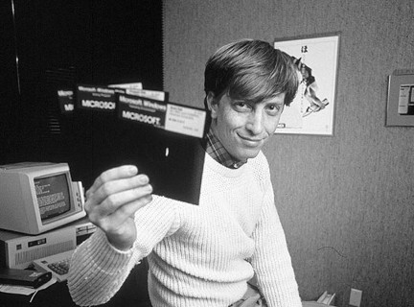
Big Data Is Not New
1976 – physical disk formats: hard-sectored 90 KB and soft-sectored 110 KB
1983 - single-sided media, with formatted capacities of 360 KB
1984 – double-sided media, with formatted capacities of 720 KB
1986 - What became the most common format, the double-sided, high-density (HD) 1.44 MB disk drive.

Slide 5
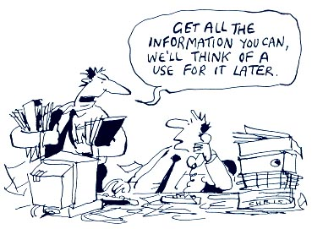
So What is New and Why All of the Hype NOW?
Unprecedented ability to store Data
Unprecedented amounts and types of data
Unprecedented Computing Power
Unprecedented Ability to reach data and information from anywhere in the world in Near Real Time

Slide 6
Data
Derived Information
Knowledge – Data in Motion
Intelligence
Analyst Interface
Forensic Big Data Repositories
Real-Time Network Sensors
Actionable Intelligence
Domain Expertise
Threat Vectors
Decision Maker
Automate Screening Results in Display
Near Real-Time Forensics
Milliseconds
Ingest volume, velocity variety and veracity of data
Bring computing power to correlate vast amounts of data and create derived information
Intuitive, comprehensive, analyst and decision maker interface
Instantaneous time to value from data to actionable intelligence

Slide 7
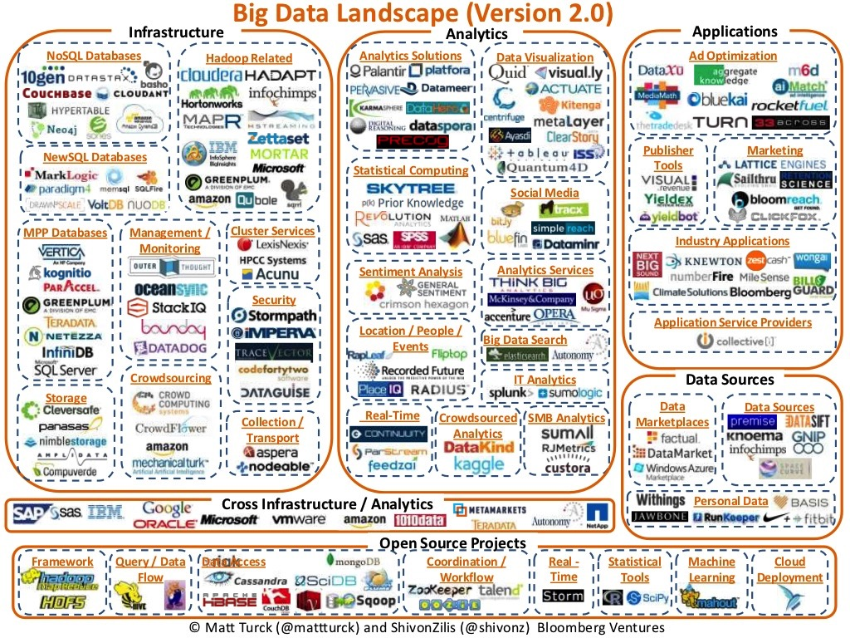
Time to value matters
Just because you can build a solution from scratch doesn’t mean you should!

Slide 8
Thank You!

