Slide 2
The “Flipped Classroom” Experience
Chris DiPalma, P.E.
Operations Discipline Champion
Federal Highway Administration
Office of Operations

Slide 3
The Challenge
Scale training for a distributed workforce

Slide 4
The Original Solution
2 hour live webinars
Declining participation

Slide 5
The Transformation
5-10 minute videos
Online discussion

Slide 6
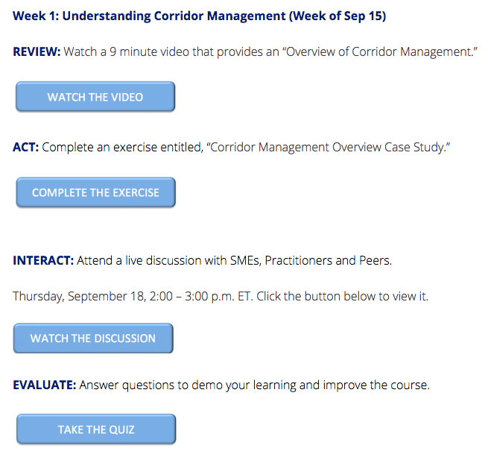
Flipped Classroom Course Structure
Converted existing content to fresh format
Structured the course in a flipped classroom style
Participants viewed micro-learning videos, discussed case studies and joined a live knowledge exchange with subject matter experts
Continuously evaluated through polls and quizzes.

Slide 7
Content Optimization
Short, narrated slides based on SME interviews
Adjusted format from narrated slides to radio show format in Week 3.
Incorporated animation

Slide 8
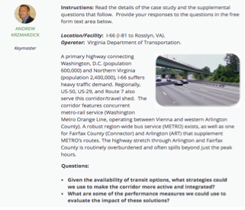
Facilitated Online Engagement
HANDS-ON CASE STUDIES
LIVE DISCUSSION

Slide 9
Results and Feedback
94% : “the instructors were effective in conveying course information.”
83% : “there was enough interaction to keep me engaged throughout the course.”
87% : “the content is valuable in helping me to implement Corridor Management in my division.“
85% : live webinars were effective or highly effective
85% : online discussions were effective or highly effective
“This session was great!”
“Like the format”
“I like the use of the White Boards to pull in verbal and chat comments”
“I did like the ‘flipped classroom’ format.”
“Really like the flexible time and location to participate in this course.”
“This course along with the format was effective and great.”

Slide 10
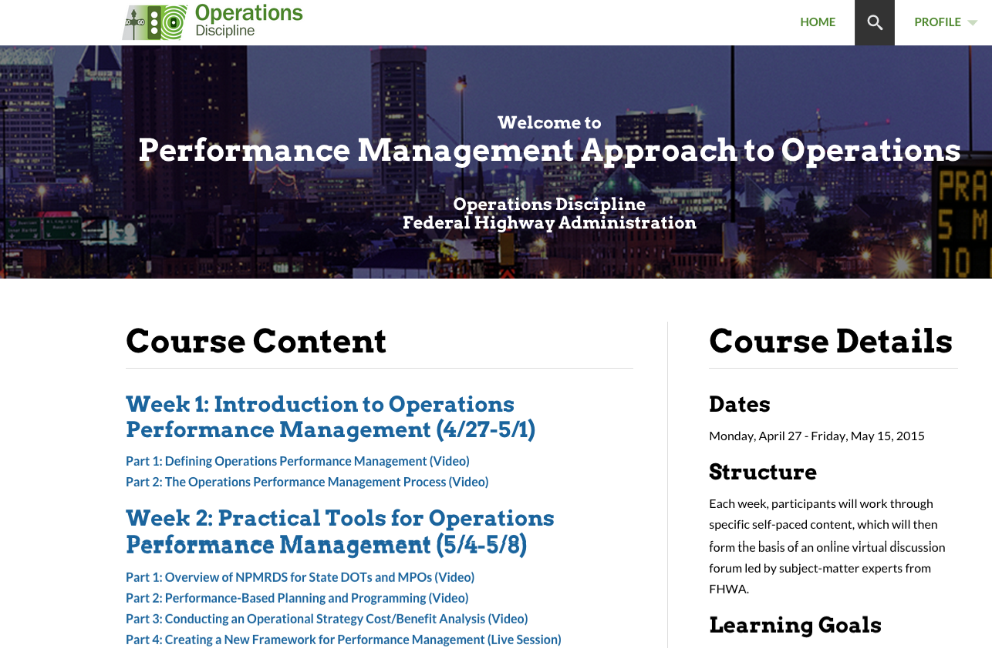
Next Steps
Facilitate another 3-week learning experiences using a similar format
Incorporate both videos and interactive exercises

Slide 11
For More Information
Chris DiPalma
Operations Discipline Champion
(360) 619-7835
chris.dipalma@dot.gov

