Slide 2
FHWA’s Social Learning Experience “Leap Not Creep: Accelerating Innovation Implementation”

Slide 3
Purpose of Course
7 Fed, State, Local Innovation Teams
Create an Implementation Plan in 2 Months
1
2
3
4
5
6
7

Slide 4
The Challenge
Interactive Onsite Course
Boring Virtual Course

Slide 5
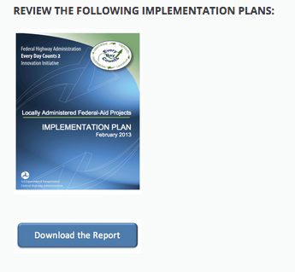
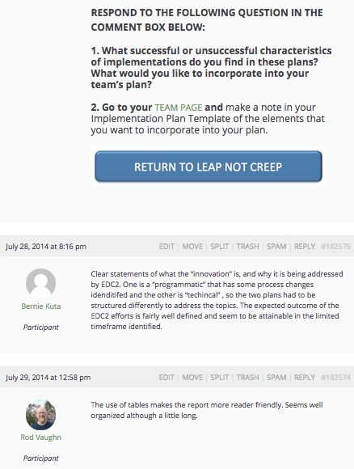
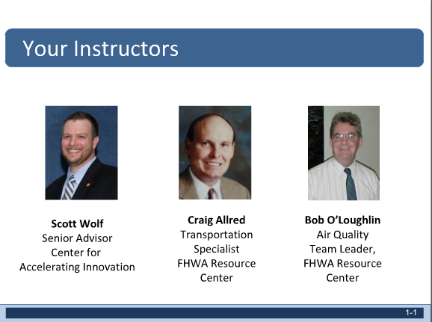
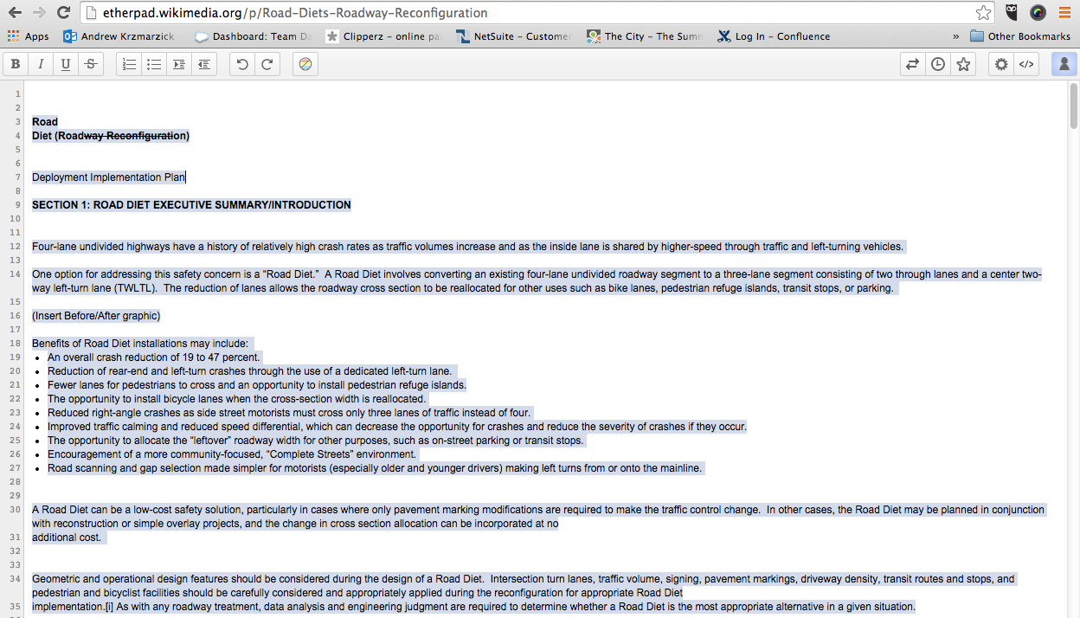
The Solution
LIVE SESSIONS IN ADOBE CONNECT
READINGS & ONLINE DISCUSSIONS
Tools: webinars, readings, online discussions and collaborative wikis (aka live editing tools)
Team specific activity followed live sessions
Apply concepts immediately after learning
EMBEDDED COLLABORATIVE WIKIS

Slide 6
Social Learning: Built in Weeks
Agile course development
Organized by implementation plan content
Issued initial course materials through week 3
Adjusted subsequent materials weekly based on learner input
Implementation Plan
Table of Contents
Overview and Innovation Description
Mission Statement
Goals
Target Audience
Market Research
Performance Measures
Work Plan

Slide 7
Lessons Learned
2. Plan Long-Term User Needs
3. Self-paced content bonus, not priority
4. Dry-runs; tighten content; test videos
1. Pre-Register Participants

Slide 8
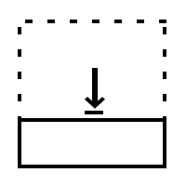
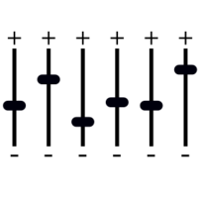
Lessons Learned
5. Limit Live Instruction to One Hour
6. Increase Live Time for Teams
7. Shorten Course to Five Weeks
8. Adjust Content As You Go

Slide 9
Questions?
Julie Zirlin
Technology Partnerships Coordinator
Julie.Zirlin@dot.gov

