Slide 1
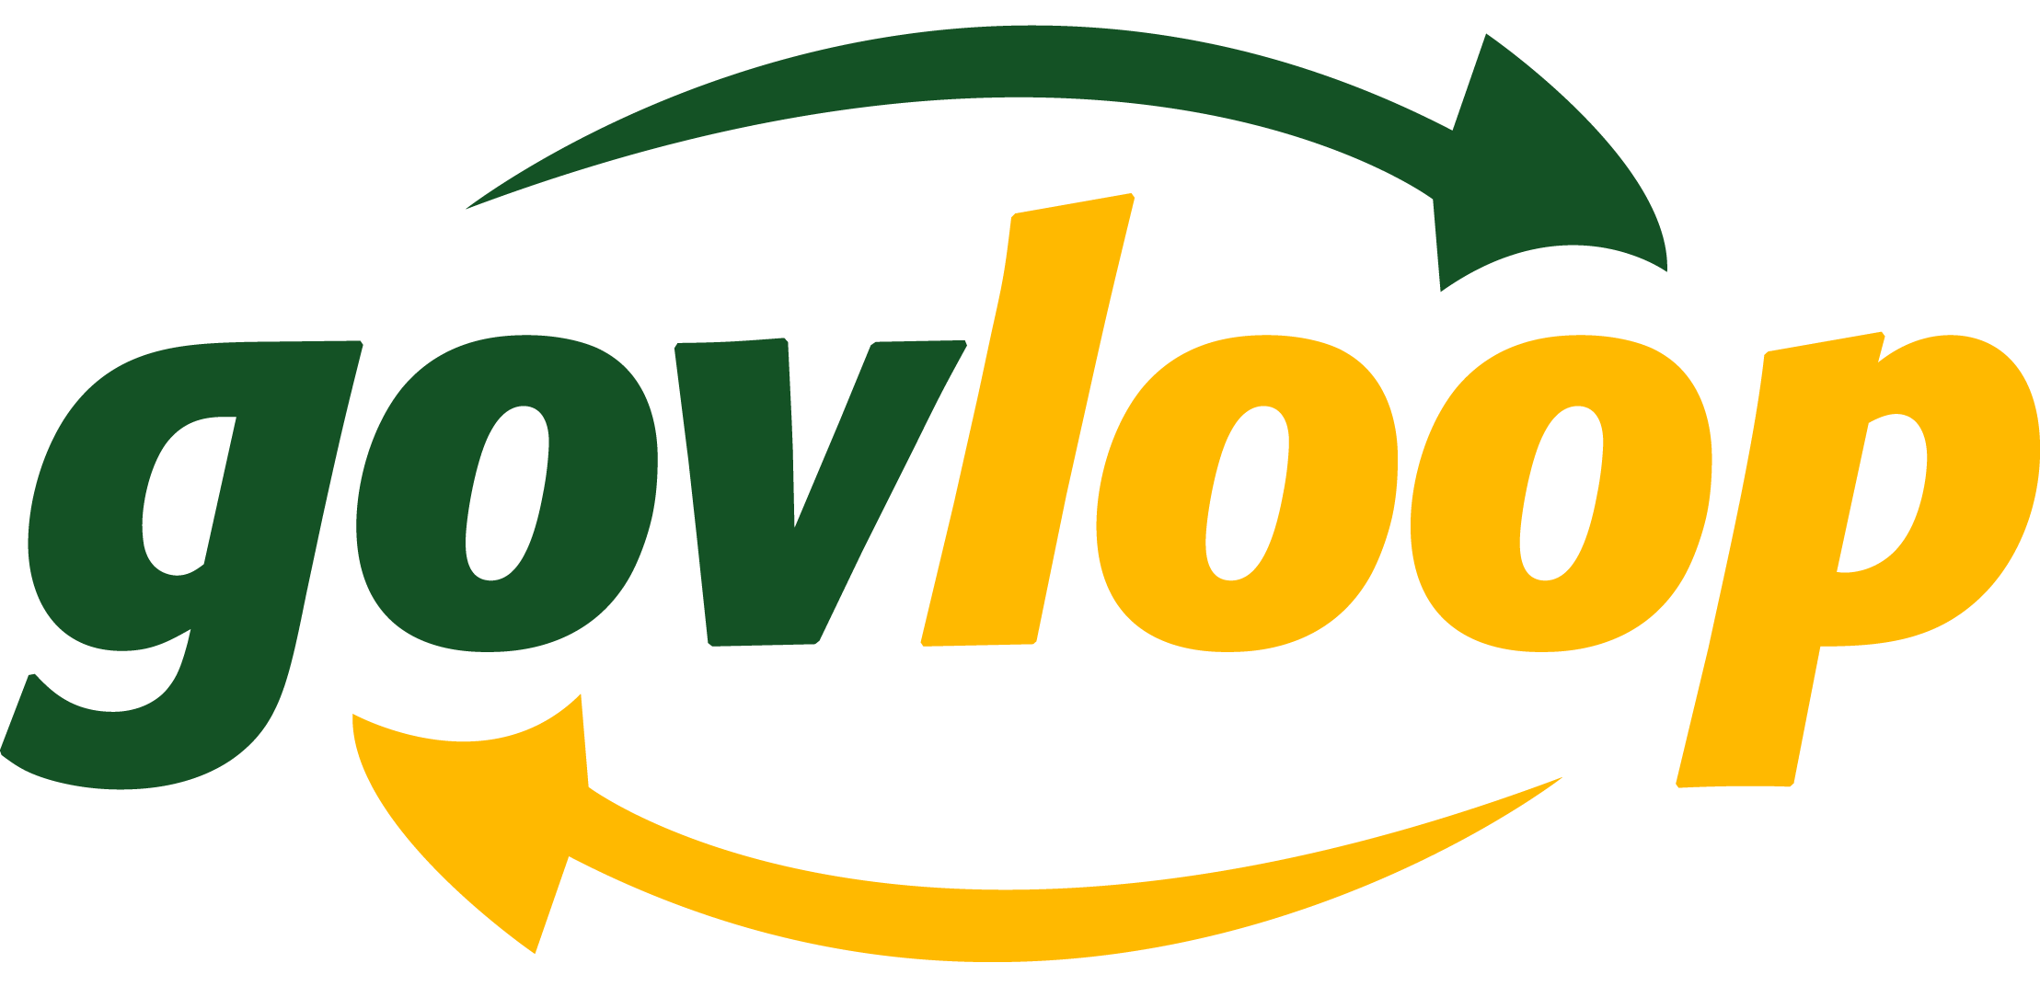
The Future of Learning
3 Key Trends in Government Training
Steve Ressler
Founder and President, GovLoop

Slide 2
1. Learning Must Be Practical.
Moment of need is in real-time, on the job.
Need information that’s immediately applicable .

Slide 3
2. Learning Must Be Social.
We will always learn from one another.
So how do we replicate that reality online?

Slide 4
3. Learning Must Be Mobile.
Our workforce needs access everywhere…
…and content must look good on small screens.

Slide 5
Intentionally Blank

Slide 6
What’s the natural evolution of…
?

Slide 7
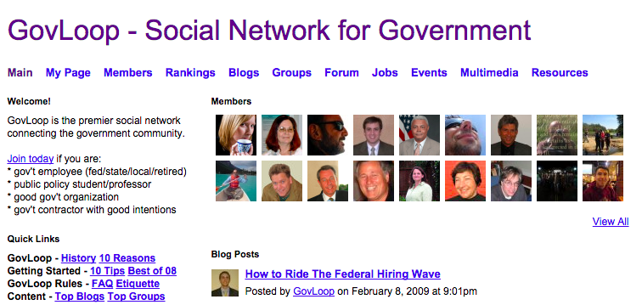
Original Idea
Facebook For Feds
Social network for government
Launched 5+ years ago

Slide 8
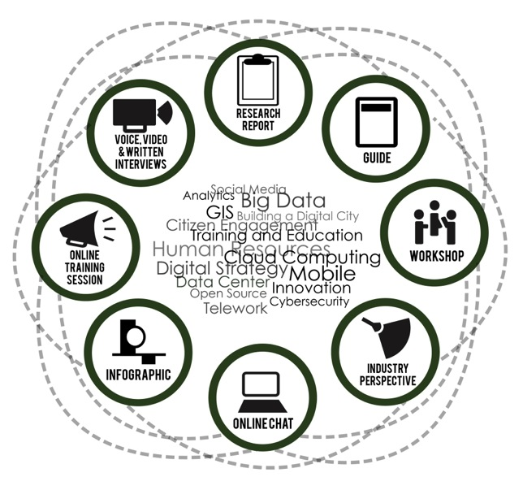
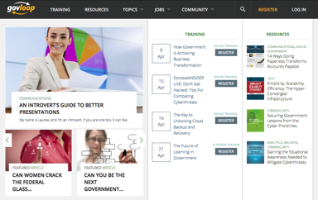
GovLoop: “Knowledge Network”

Slide 9
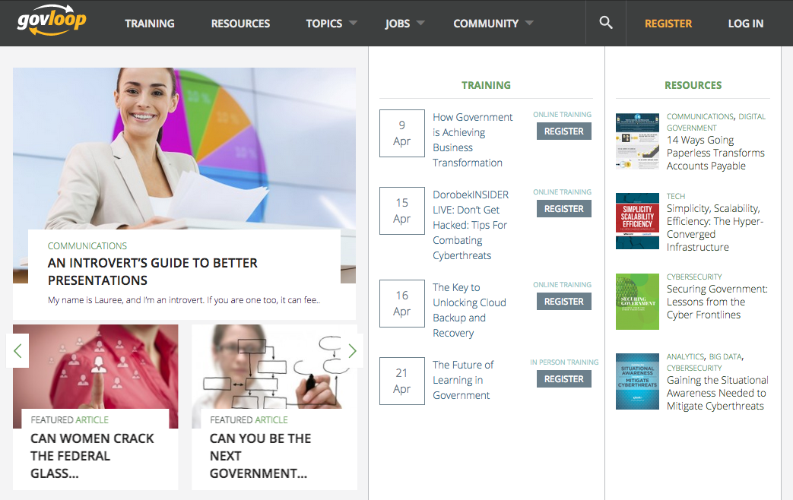
Learning Hub for Government
Real-time access to peers and experts
30,000+ took our free online training in 2014 alone
OPM approached us to do a “social learning” pilot

Slide 10
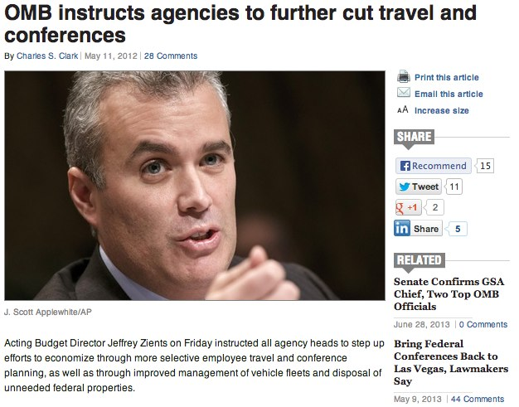
Government Training Trends
Training budgets cut
Travel for restrictions for conferences
Increasingly distributed, mobile workforce

Slide 11
New World of Training
New methodologies and models of engagements
Talked to CEOs of learning innovators
New models of engagement

Slide 12
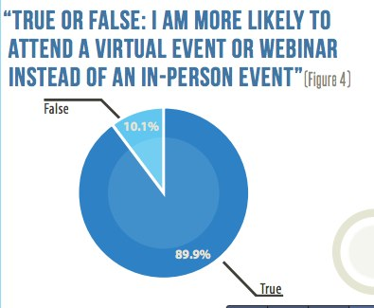
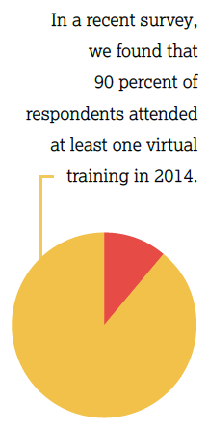
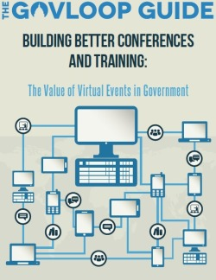
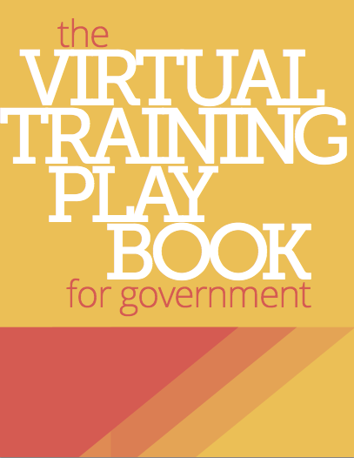
Research & Discovery
Survey of 350+ government employees
Interviews with dozens of training experts
Input from 150,000 GovLoop members

Slide 13
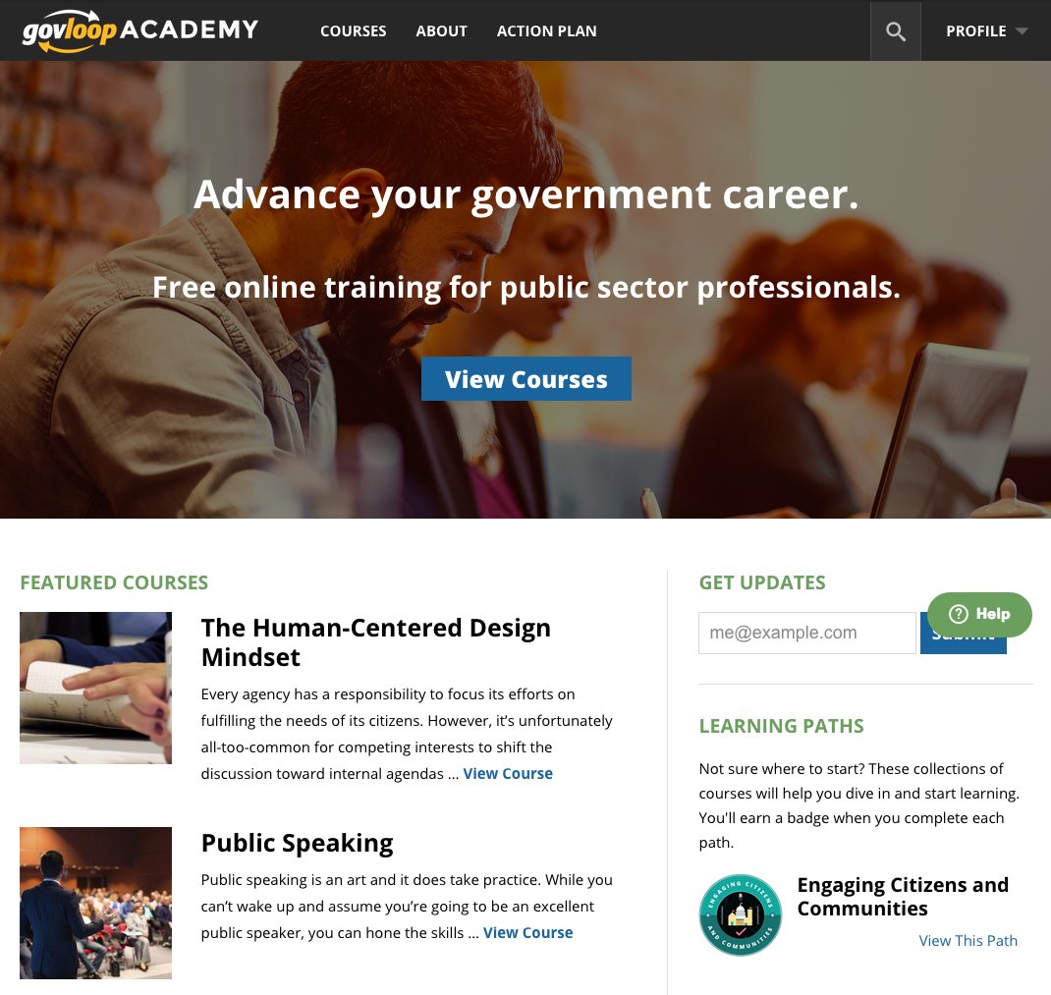
Our next step…
GovLoop Community
GovLoop Academy
Notes:
As you know, GovLoop’s learning portal is a bit like an LMS with the capability to authenticate users through OMB MAX. We also create engaging online training content from agencies’ existing classroom-based courses and help agencies to improve the delivery of the online content that they already have. GovLoop’s marketing services through our parent company, GovDelivery, are a key part of how we support agencies to effectively promote their training and drive increased course registrations.
These three pieces working together function a bit like a cycle because good promotion drives learners to a great platform that drives registrations for awesome courses with engaging content which in turn helps to further promote the courses through happy customers who will spread the word about your great training through word of mouth. Unless you have all of these pieces in place, we think you’re really losing out on valuable opportunities for effective learning experiences for your students.

Slide 14
Real-Time Learning for Government
GovLoop Academy
Vision: hundreds of free, short, high impact learning experiences
Custom and remixed content
Quizzes, badges and certificates
Action plans and mentoring
Notes:
As you know, GovLoop’s learning portal is a bit like an LMS with the capability to authenticate users through OMB MAX. We also create engaging online training content from agencies’ existing classroom-based courses and help agencies to improve the delivery of the online content that they already have. GovLoop’s marketing services through our parent company, GovDelivery, are a key part of how we support agencies to effectively promote their training and drive increased course registrations.
These three pieces working together function a bit like a cycle because good promotion drives learners to a great platform that drives registrations for awesome courses with engaging content which in turn helps to further promote the courses through happy customers who will spread the word about your great training through word of mouth. Unless you have all of these pieces in place, we think you’re really losing out on valuable opportunities for effective learning experiences for your students.

Slide 15
Academy.GovLoop.com

Slide 16
Questions?

Slide 17
Please visit the demo kiosks!

