Slide 2


"The Future of Learning in Government"
Our mission is to help Americans start, build, and grow businesses

Slide 3
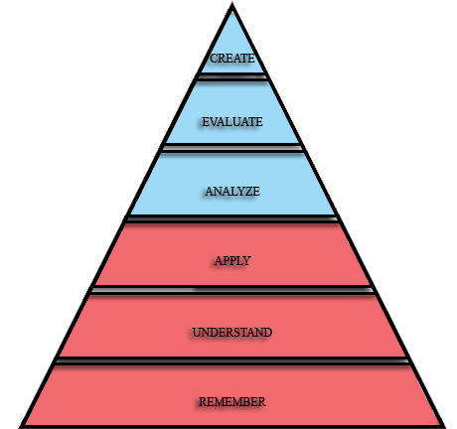
Entrepreneur education is a complex mix of knowledge, skills, and abilities.
Must meet the needs of all types of entrepreneurs and small business owners
Instructional Strategy
Bloom’s Taxonomy

Slide 4
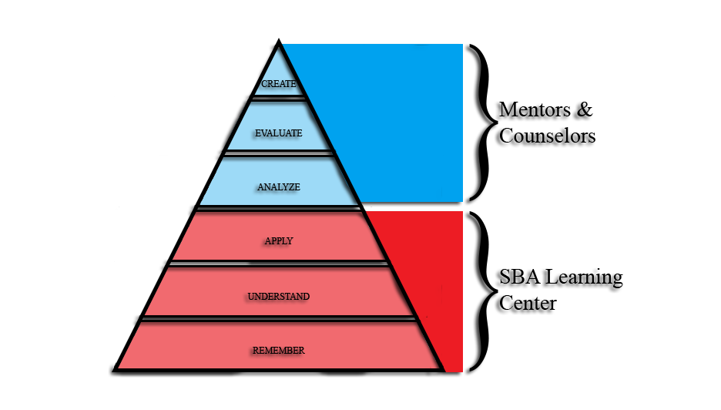
Mentor experience and education is more valuable at higher levels of learning.
Advanced learners can reach out to SBA’s diverse and skilled network of counselors and business development specialists around the country.
Instructional Strategy

Slide 5
User Business Status

Slide 6

Content Design
Just in time training.
Explain the essence business topics.
No tests
Worksheets
Checklists
Referrals

Slide 7
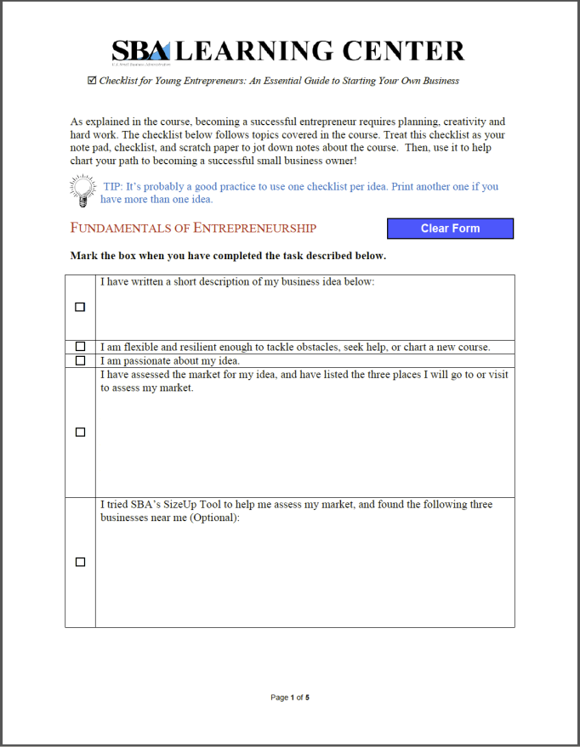
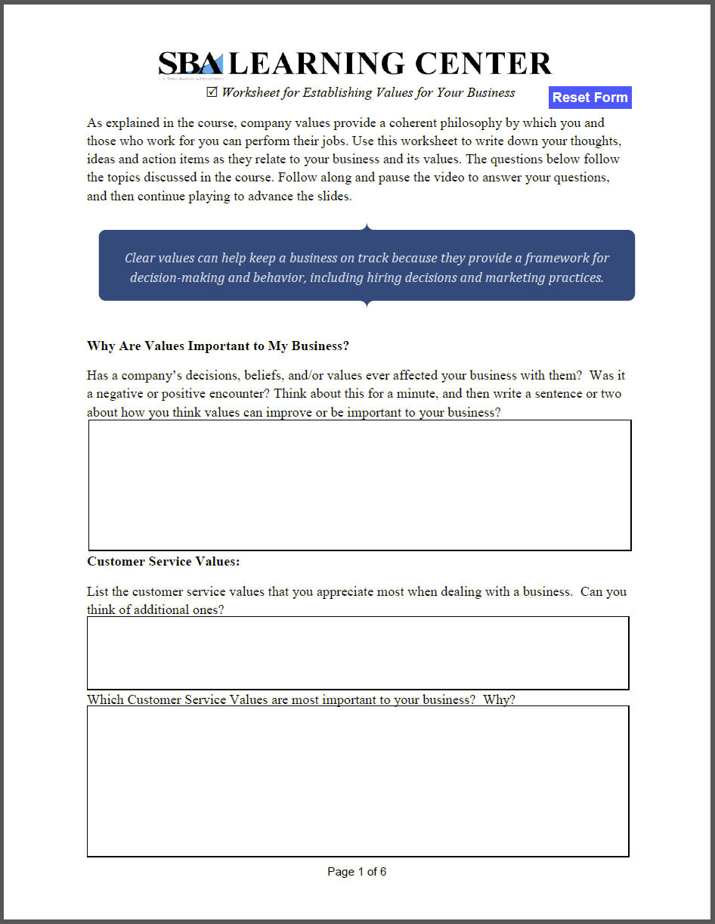
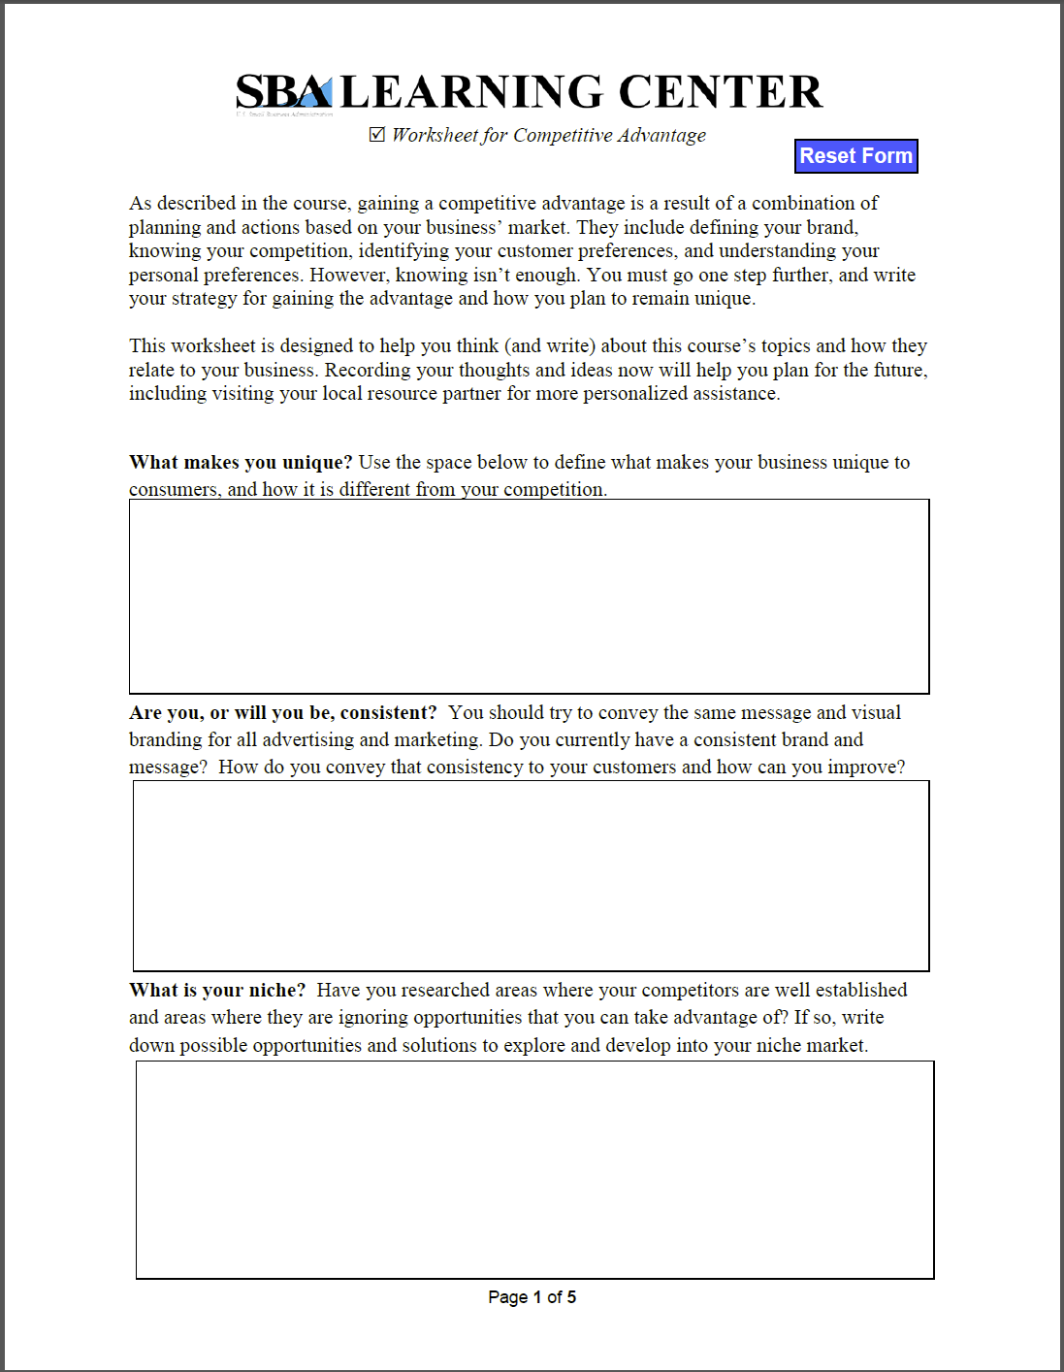
Worksheets & Checklists

Slide 8
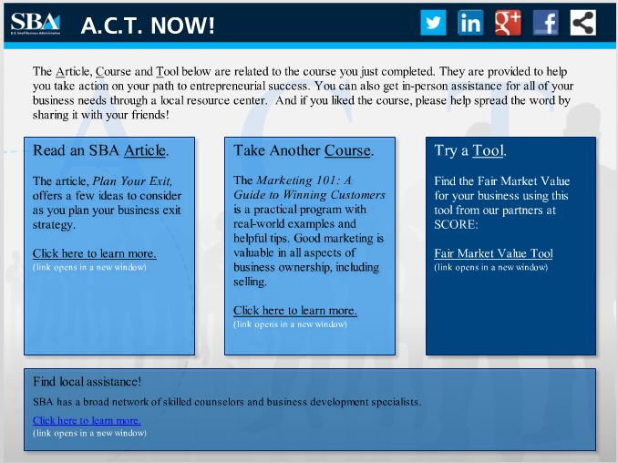
Referrals

Slide 9
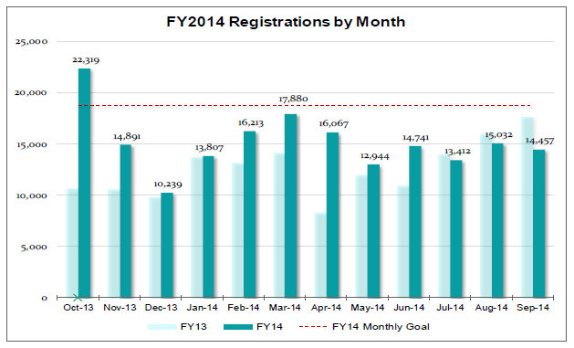
Registration Form
Collects user data before each course and helps us determine:
Who our users are
What topics or titles users are clicking on
What courses to develop and for what audience
Web Analytics
Google Analytics
AddThis
URL tracking
Metrics

Slide 10
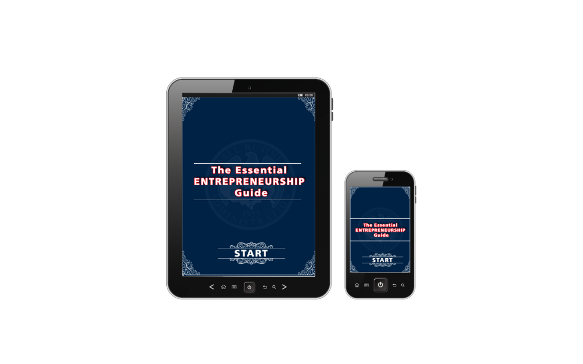

Future
Mobile
Spanish
Interactivity
Different content types

Slide 11
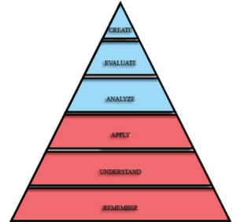
Training the Trainers
Mentors
Entrepreneurs

Slide 12
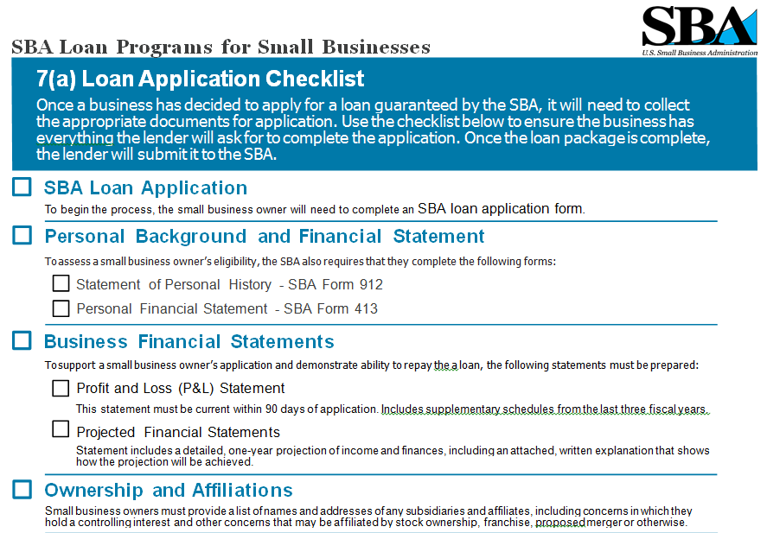
Focus Groups
Interviews
Phone calls
Email
Content types
PDF
Vignettes
Design Process

Slide 13
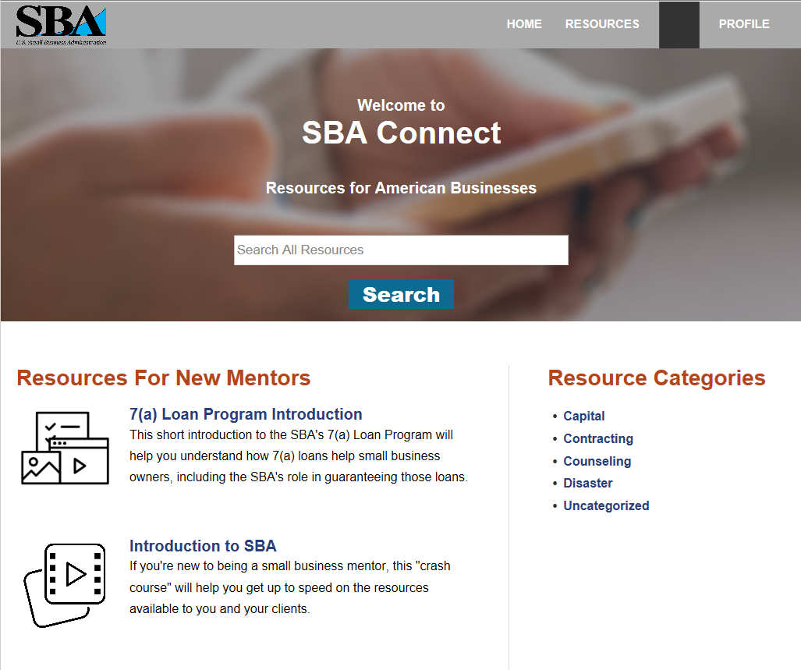
Delivery Method

Slide 14
Questions ?
Mentors
Entrepreneurs

