Slide 1
DoD and the Cloud
Rob Vietmeyer
Enterprise Services & Integration Directorate
Office of the DoD CIO
24 June 2015

Slide 2
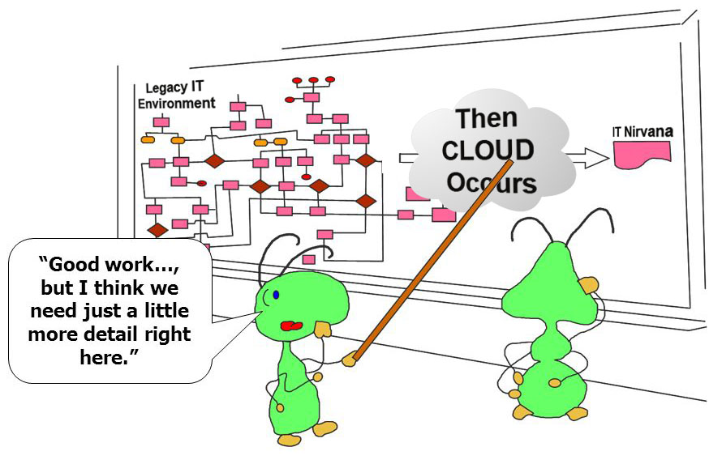

Slide 3
Want to develop your own cloud?
Challenges
Current data center operations and culture
Technology and skill set gaps
Transition to agile development and DevOps
Transition to “customer” focused operations
Are your “customers” ready?

Slide 4
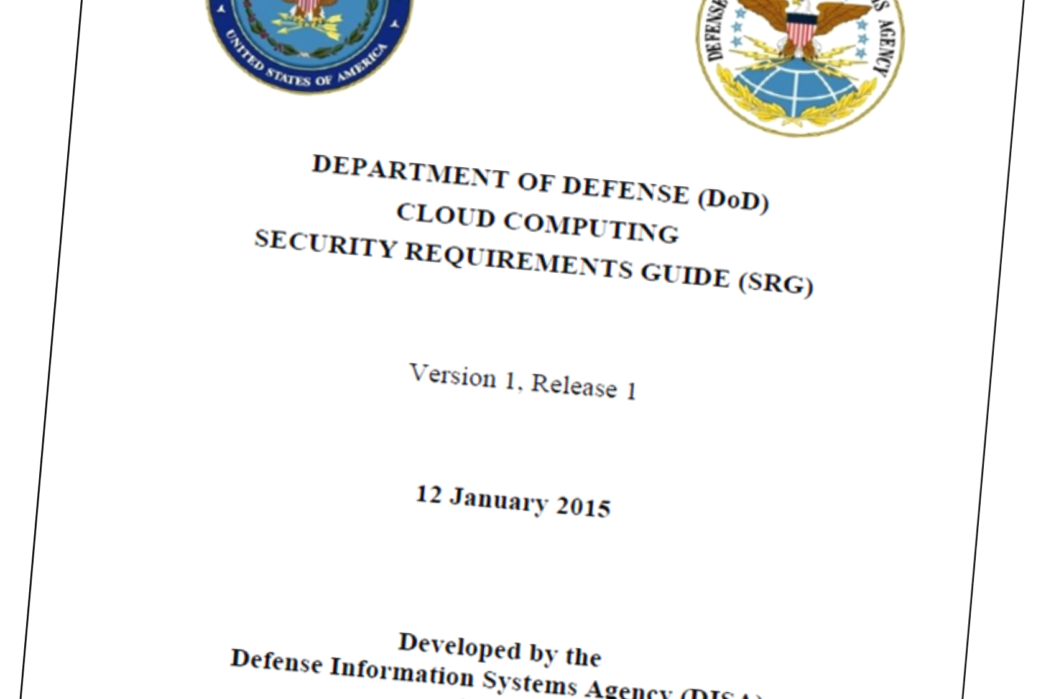

Slide 5
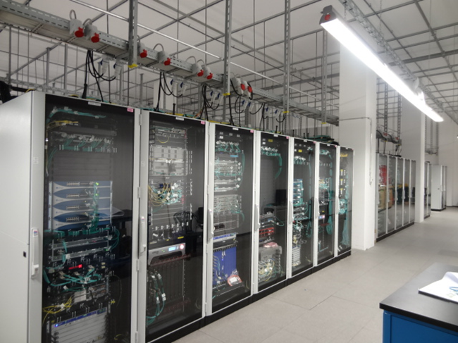
Computer Network Defense
Intrusion Detection System
Intrusion Prevention System
Firewall
Logging & Analysis
Network Whitelist
Zero day

Slide 6
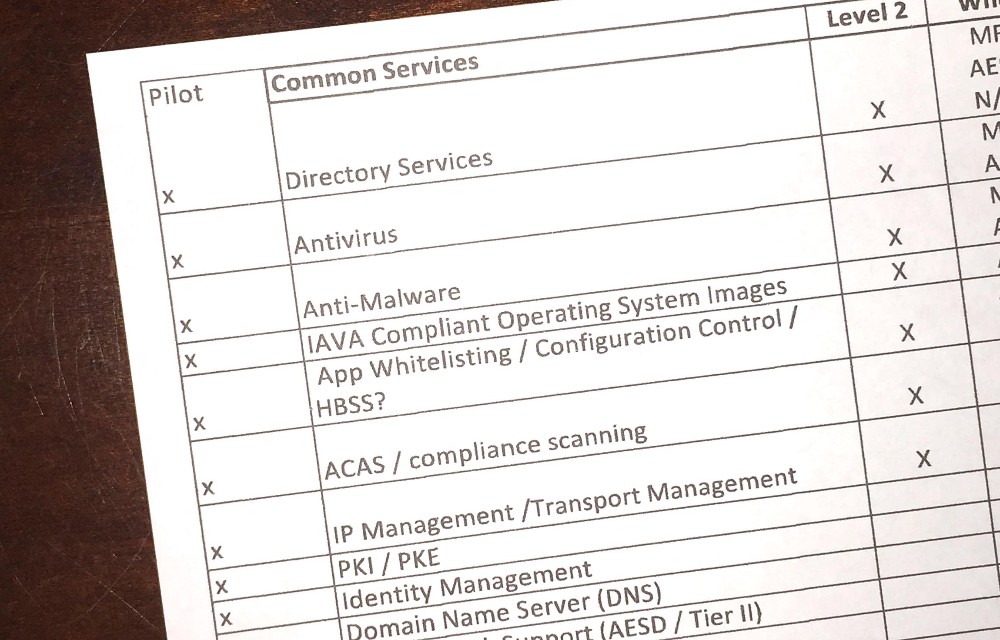

Slide 7
Want to develop your own cloud?
Challenges
Current data center operations and culture
Technology and skill set gaps
Transition to agile development and DevOps
Transition to “customer” focused operations
Are your “customers” ready?

