Slide 1
Cyber Basics and Big Data

Slide 2
Data and Complexity
Data
Analytics
Machine Created - logs
Email
Video – Predator Surveillance
Audio – Phone recordings
Sensor - Weather
Social Media - Twitter
Databases – Structured Text
Reports – Semi-Structured Text
Documents – Unstructured Text
Graphs – Graph Dbs
Semantic Extraction
Sentiment Analysis
Entity Extraction
Link Analysis
Temporal Analysis
Geospatial Analysis
Time Event Matrices
Predictive Pattern Analysis
Video/Imagery Analytics
A new world of analytical possibilities is opened.

Slide 3
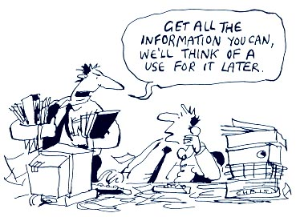
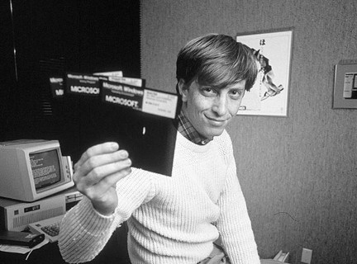
Big Data Is Not New………So why the Hype now?
1976 – physical disk formats: hard-sectored 90 KB and soft-sectored 110 KB
1983 - single-sided media, with formatted capacities of 360 KB
1984 – double-sided media, with formatted capacities of 720 KB
1986 - What became the most common format, the double-sided, high-density (HD) 1.44 MB disk drive.
Unprecedented ability to store Data
Unprecedented amounts and types of data
Unprecedented Computing Power
Unprecedented Ability to reach data and information from anywhere in the world in Near Real Time

Slide 4
Data to Knowledge to Intelligence – the Process
Data
Derived Information
Knowledge – Data in Motion
Intelligence
Analyst Interface
Forensic Big Data Repositories
Real-Time Network Sensors
Actionable Intelligence
Domain Expertise
Threat Vectors
Decision Maker
Automate Screening Results in Display
Near Real-Time Forensics
Milliseconds
Ingest volume, velocity variety and veracity of data
Bring computing power to correlate vast amounts of data and create derived information
Intuitive, comprehensive, analyst and decision maker interface
Instantaneous time to value from data to actionable intelligence

Slide 5
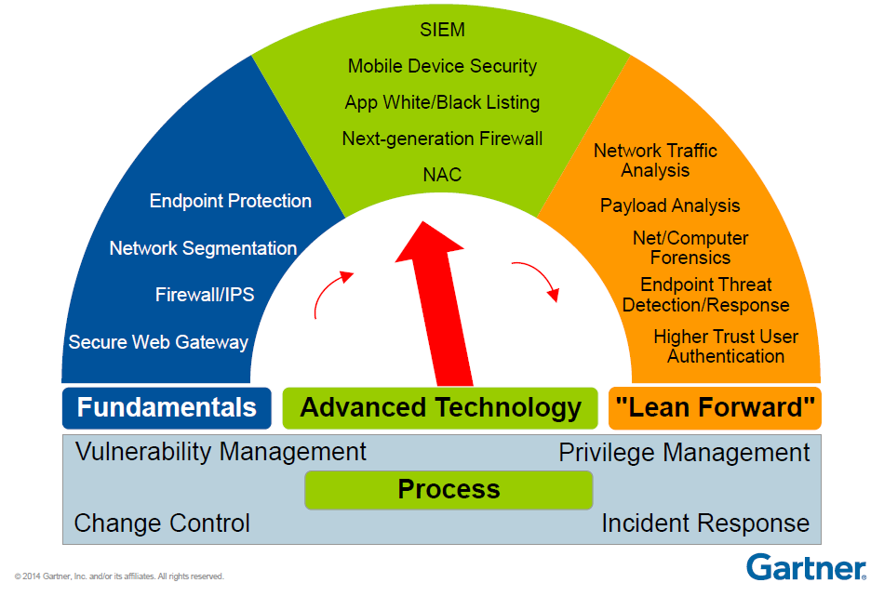
The Basics to Next Generation – Risk Management

Slide 6
The Cyber Basics Simplified
Cyber Readiness – all about establishing trust to manage risk of uncertain world
Now Virtual Trust, no longer face-to-face
How do we establish trust ‘virtually’?
First step is Identity Management
CAC cards, PIV Certificates, Trusted data base
Second Step is Authentication
Two Factor, SSL, username and password, biometrics
Third step is Access control
Rules Based Access Control tied to identity management
Last step is verification and analytics of the business process
Audit and trace of all of the above steps
Time matters to the above process for the person at the keyboard, mouse, mobile device, etc.

Slide 7
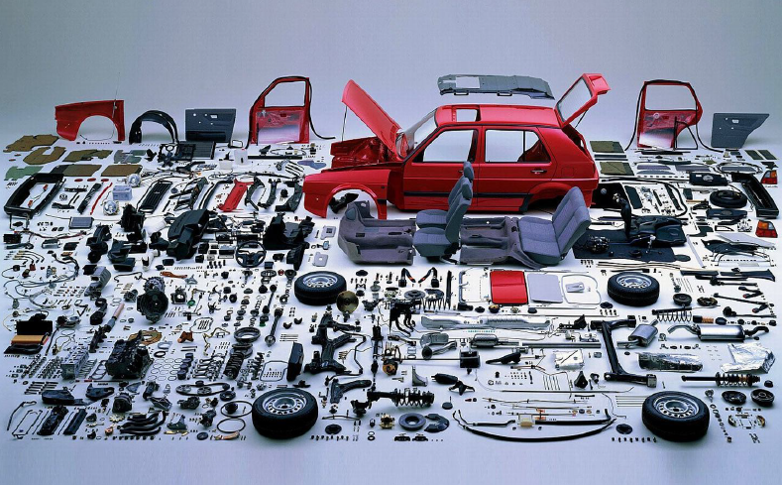
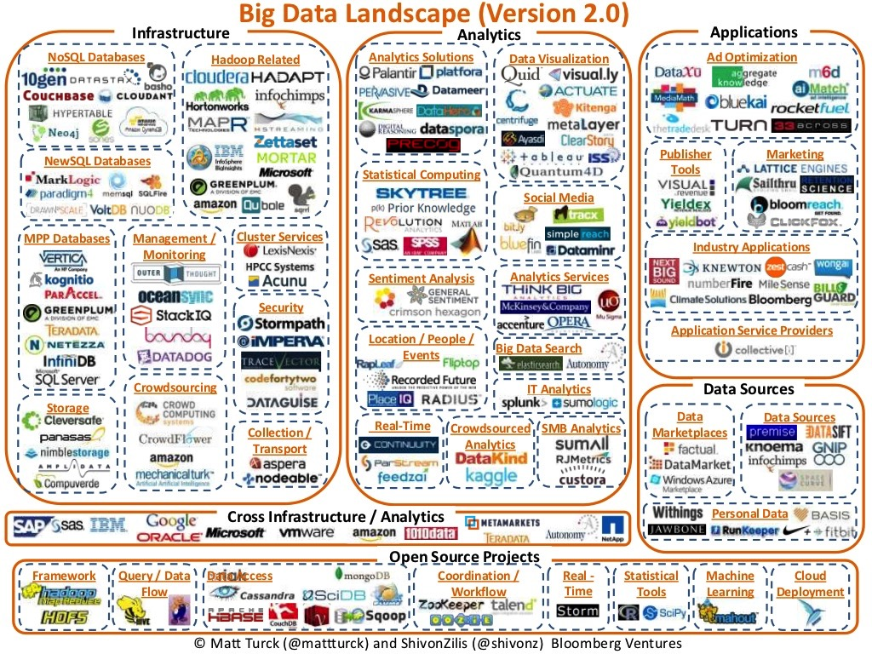
Time to value matters
Just because you can build a solution from scratch doesn’t mean you should!

Slide 8
Thank You!

