Slide 1
.
USDA and Data Analytics
GovLoop
Presented by
Joyce Hunter
USDA Deputy Chief Information Officer for Policy and Planning
Notes:
OMB Memo 13-13 released last year, requires federal agencies to develop and release data that can be used by other government agencies, industry, academia, and the public.
It also requires Agencies to develop and maintain and enterprise data inventory that can be Expanded, Enriched and is Open.
It requires Agencies to make their data machine readable and using open formats and data standards for new information development and collection. It requires Agencies to use open licenses and establishes processes that will identify information that can not be release for various reasons. (privacy, legal, security)

Slide 2
USDA Open Data
The United States Department of Agriculture (USDA) is committed to improving its processes to effectively engage internal and external stakeholders by working closely with leaders from government, industry, academia, and the public.
Decades ago, the Federal Government made both the National Oceanic Atmospheric Administration (NOAA) weather data and the Global Positioning System (GPS) data freely available to the public. Since then, American entrepreneurs and innovators have used these resources to create navigation systems, weather newscasts and warning systems, location based applications (“apps”), precision agriculture tools, and much more, all of which help fuel entrepreneurship, innovation, and scientific discovery. These have greatly improved American lives and contributed significantly to job creation.
The USDA Open Data Initiative (OpenAg) expands and promotes a culture of Open Government among the Department by making its information resources widely accessible, discoverable, and usable by Federal government agencies and by the general public.
Notes:
OMB Memo 13-13 released last year, requires federal agencies to develop and release data that can be used by other government agencies, industry, academia, and the public.
It also requires Agencies to develop and maintain and enterprise data inventory that can be Expanded, Enriched and is Open.
It requires Agencies to make their data machine readable and using open formats and data standards for new information development and collection. It requires Agencies to use open licenses and establishes processes that will identify information that can not be release for various reasons. (privacy, legal, security)

Slide 3
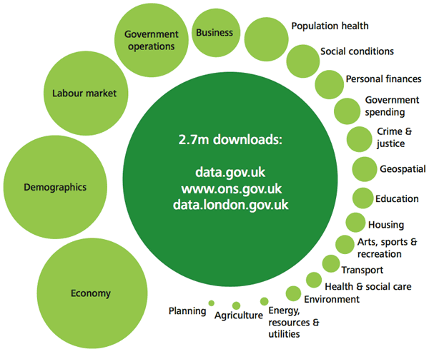
USDA Open Data
USDA is the cornerstone for the Global Open Data for Agriculture and Nutrition (GODAN) Imitative. GODAN supports efforts to make agriculturally and nutritionally relevant data available for public global use.
Open data on agriculture, nutrition and food systems can be a powerful tool for long-term sustainable development by improving the economic opportunities for farmers and the health of all consumers.
The initiative encourages collaboration and cooperation among existing agriculture and open data activities, and brings together all stakeholders to solve long-standing global problems.
Published over 500 data sets for public consumption via the federal repository Data.gov
Developed repeatable processes to ensure USDA data continues to be available, reliable and accessible for the public
Constantly improving our customer engagement and customer feedback processes to ensure the deliver of high-valued datasets
Actively support Civic Hackathons by providing Agricultural Data, such as:
Food Safety Data
Food Nutrition Data
Food Location Data
Soil and Water Data
Crop and Farm Data
Developing Open Data Standards
Creating an Agricultural Domain within the Department of Homeland Security (DHS) National Information Exchange Model (NIEM)
Working closely with the Precision Ag and Ag Gateway industry partners to develop a common set of standards
Notes:
OMB Memo 13-13 released last year, requires federal agencies to develop and release data that can be used by other government agencies, industry, academia, and the public.
It also requires Agencies to develop and maintain and enterprise data inventory that can be Expanded, Enriched and is Open.
It requires Agencies to make their data machine readable and using open formats and data standards for new information development and collection. It requires Agencies to use open licenses and establishes processes that will identify information that can not be release for various reasons. (privacy, legal, security)

Slide 4
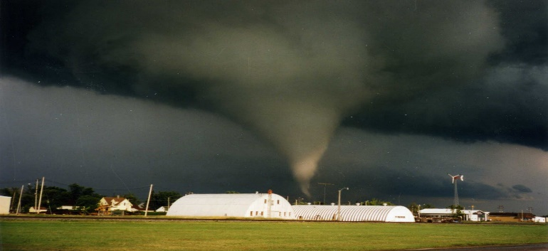
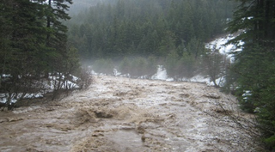
Open Data Projects
Office of the Secretary (OSEC) Disaster Clearinghouse Project
Develop a one-stop application for disaster victims to find assistance before, during and after a disaster
Project sponsor - Dr. Ann Mills of OSEC
Completed requirements, preliminary Web Design, and User’s Test
Final design and user test is underway
Project is expected to complete by September 2015
Census Find it and Connect it (FINCI) Project
Developed a pilot using USDA, NOAA and Census data to determine the economic impact of a flood on Consumers in Johnstown, PA.
Worked collaboratively with Census and the National Institute of Standards and Technology (NIST) to explore methods to create a common set of standards that potentially could be used across the federal government
Census One City, One Problem – Software Development Kit (SDK) Project
Unlocking the value of open data to promote economic growth, fuel innovation and entrepreneurship
Enabling cities and counties to use data to deliver tangible and transformative results for their communities
Provided USDA Open Data to facilitate the Chicago and Baltimore Hackathons
Notes:
OMB Memo 13-13 released last year, requires federal agencies to develop and release data that can be used by other government agencies, industry, academia, and the public.
It also requires Agencies to develop and maintain and enterprise data inventory that can be Expanded, Enriched and is Open.
It requires Agencies to make their data machine readable and using open formats and data standards for new information development and collection. It requires Agencies to use open licenses and establishes processes that will identify information that can not be release for various reasons. (privacy, legal, security)

Slide 5
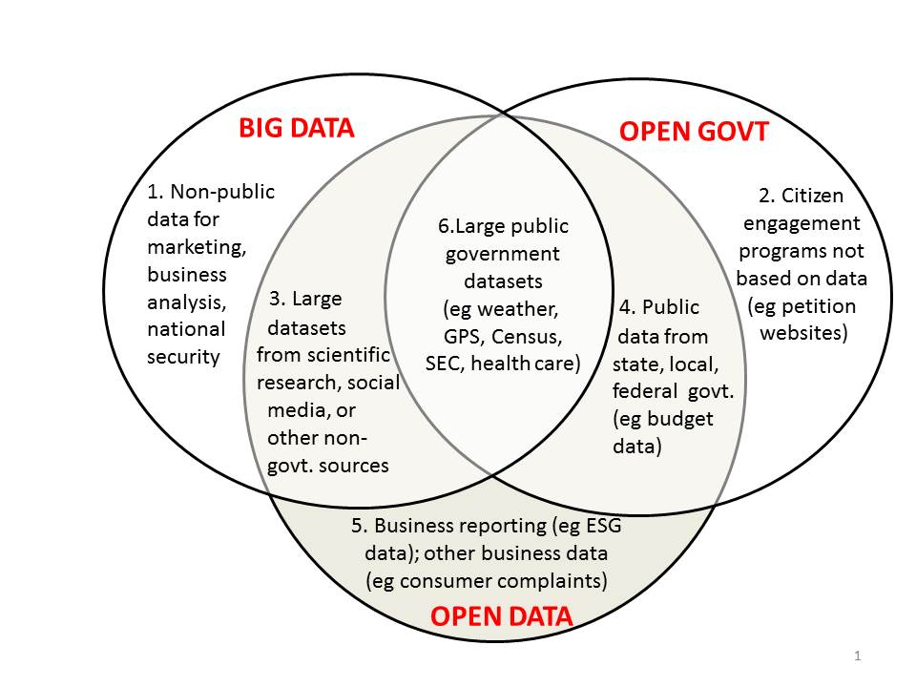
Intersection of Open Data, Big Data and
Open Government

Slide 6
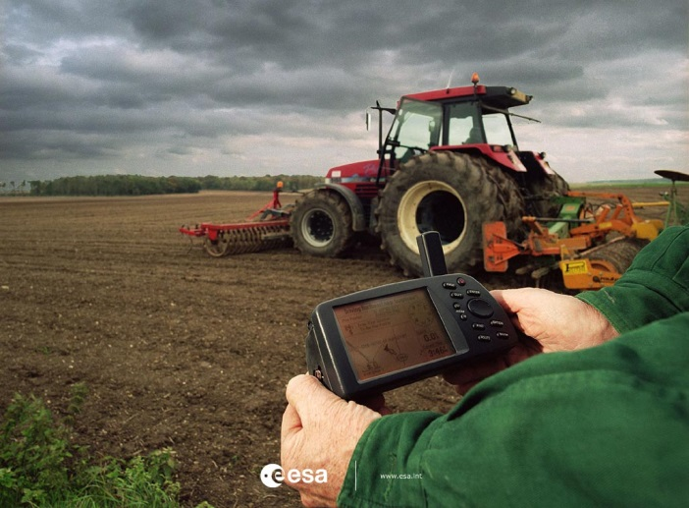
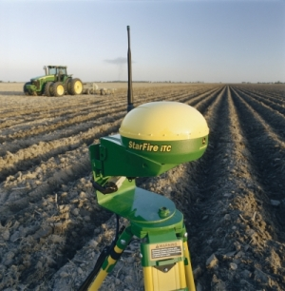
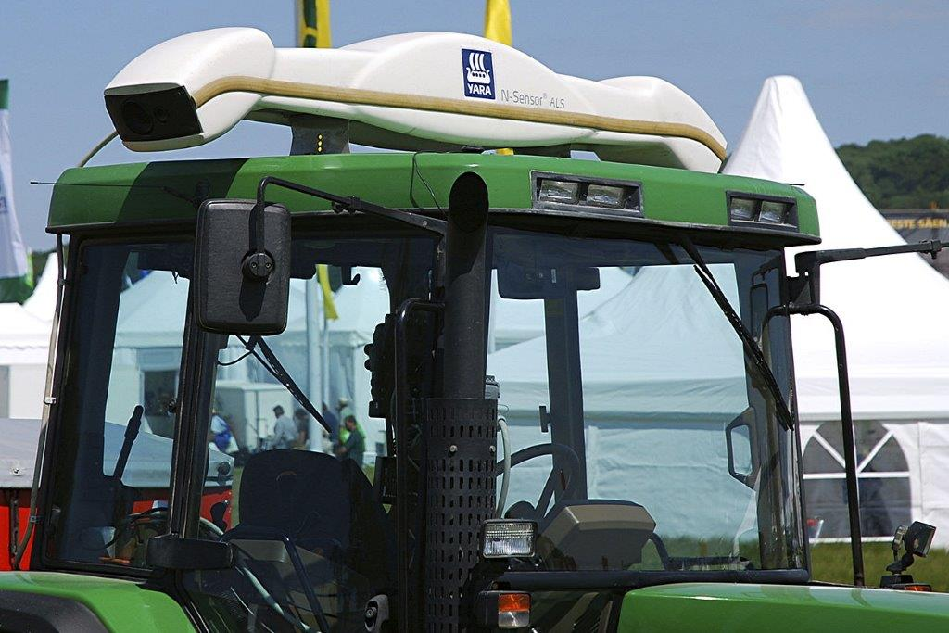
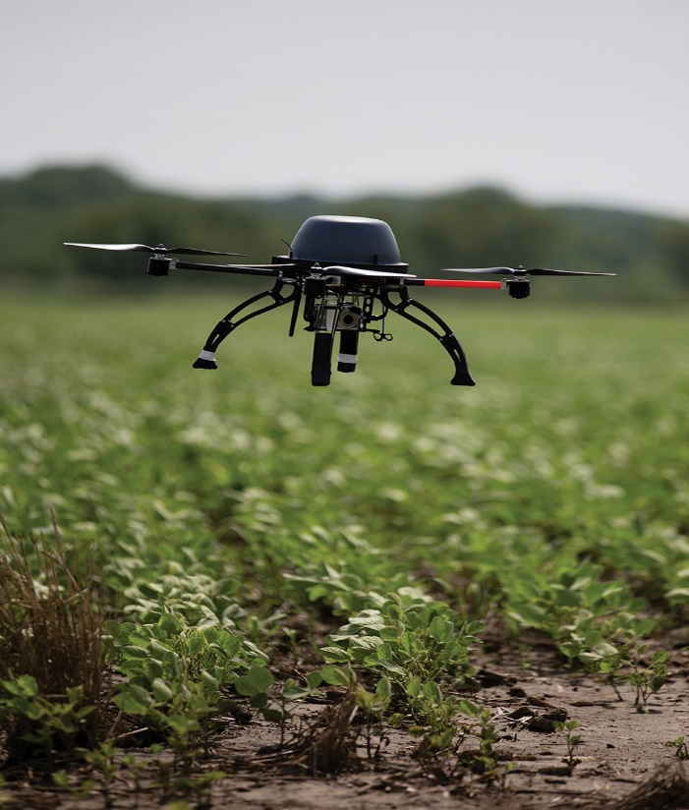
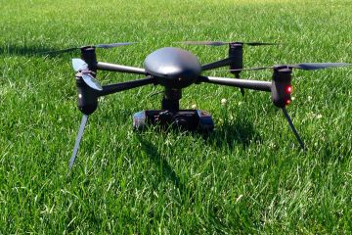
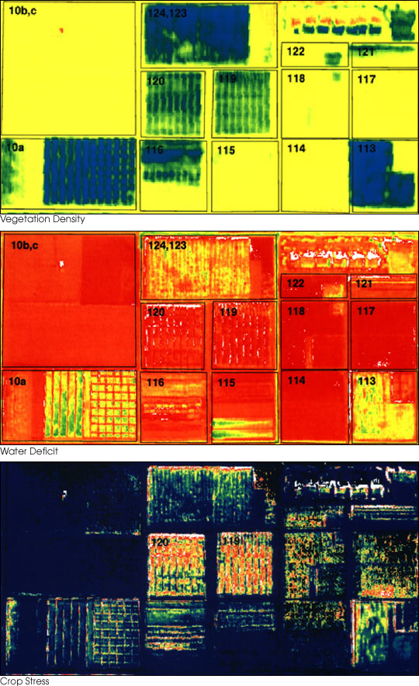
What is Precision Ag?
The holy grail of agriculture research which will be the ability to define a Decision Support System (DSS) for whole farm management with the goal of optimizing returns on inputs while preserving resources.
Allows farmers to provide customized attention to their fields.

Slide 7
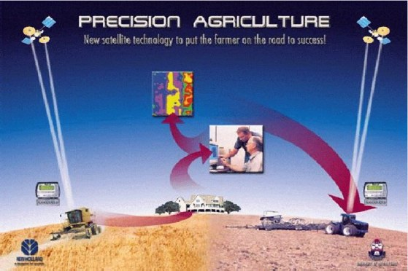
Precision Ag and Big Data
Big data is associated with Precision Ag, but is much larger than on-farm data alone:
On-Farm Precision Ag
Fertilizer, planting, crop protection
3rd Party Data
Weather, satellite / aerial imagery, soil fertility, topographic data
Research & Development
Academic / Land grant data, biotech and equipment company publications, software and analytics, and Government (ARS data)
Commodity Markets
Local, regional, global

Slide 8
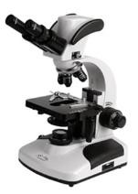
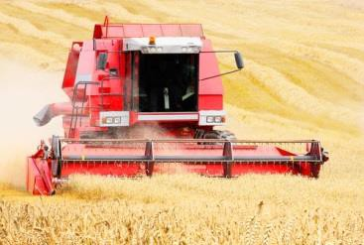
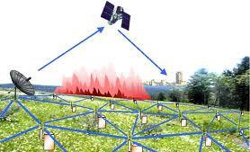
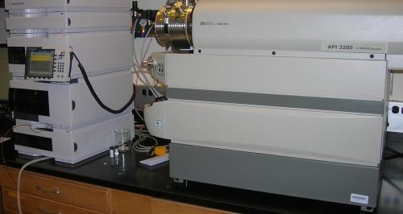
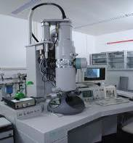
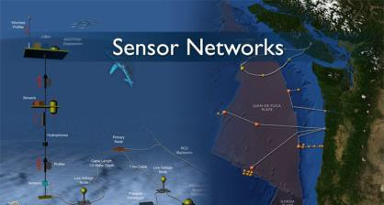
What Is Generating Big Data?
Sensor Technology and Networks (measuring all kinds of data)
Scientific Instruments
(collecting all sorts of data)
Mobile Devices
(tracking all objects all the time)

Slide 9
Value Generated by Ag Big Data
Value of Precision Ag Data
Making the link between
On-Farm Optimization
Data-based decision-making for many more decisions
Early problem identification for management response
Custom solutions minimize inputs to achieve production goals (yield and quality) dependent upon the market
Input Product Innovation for Unique Conditions
Biotech / seed research
Equipment R&D
Productive Analysis & Decision Support
Market Linkage
Improves transparency and predictability of markets

Slide 10
Enabling Farmers to Make 40 Critical Decisions
Decision Support for Farmers
Critical Decision Sets:
Planning Data Seed Selection Weed- Control Program Pest Pathogen- Control Program | Pre-Planting Data Fertility Program Tillage Program | Planting Data Plant Population Dynamics Seed Depth Timing | In-Season Data Post- Emergence Pest Control Crop Diagnostics Quality & Market Factors | Harvest Data Equipment Crop Marketing
Goal: Maximize Net Return Per Acre
Productivity Tools:
Seed
Factors
Seed is lynchpin decision – key to establishing yield potential
Planting Factors
Focus on best field configuration, preparation and planting elements
Pest-Control Factors
Focus on insect, weed, and disease control regimes
In-Season Decisions
Diseases, nutrient, etc. approaches based on in-field environment

Slide 11
Farmer Profitability Strategy
Pioneer Farmer Profitability Strategy
Whole Farm Profitability Services
Examples of Current Services Offering
Field-by-field crop plans
Planting maps
Harvest maps
Crop insurance
Financial services
Grain marketing
Harvest / Evaluate
Plan
Monitor
Plant
Tools to deliver additional insights for advanced farmer profitability.

Slide 12
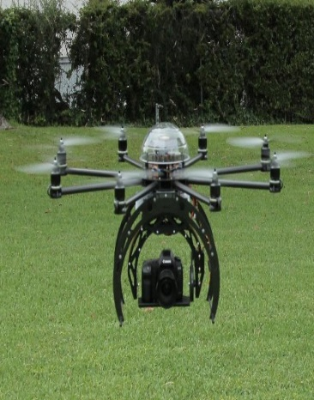
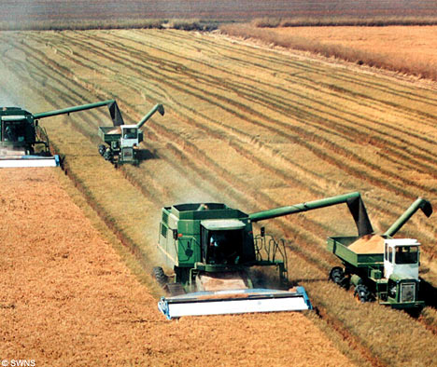
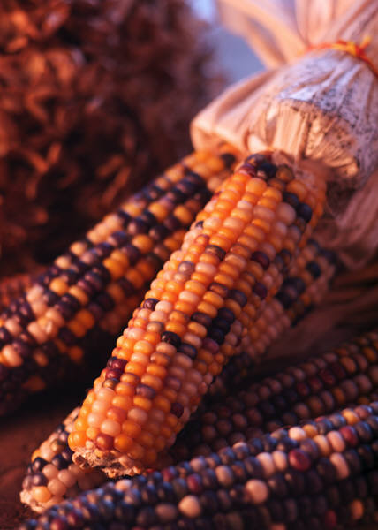
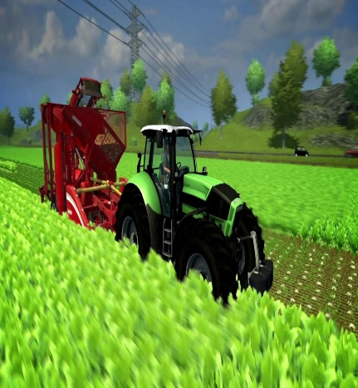
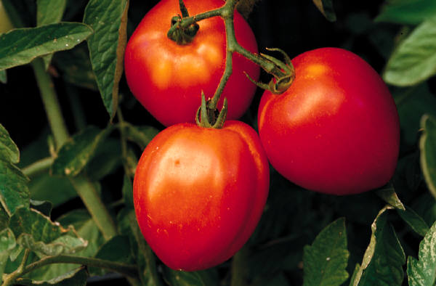
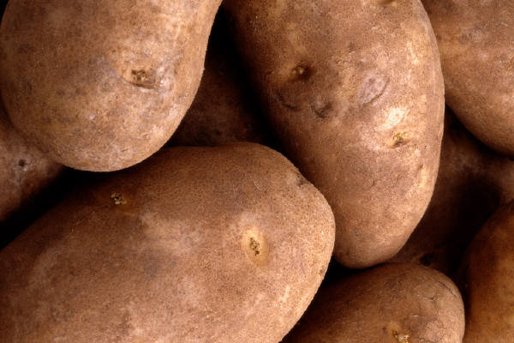
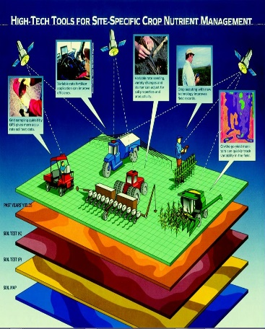
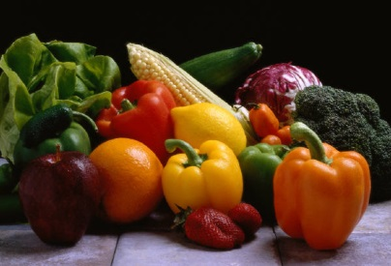
Precision Ag Delivers…
12

Slide 13
Questions
Joyce Hunter
USDA Deputy CIO for Policy and Planning
202-720-8833
joyce.hunter@ocio.usda.gov
13

